Slide 1
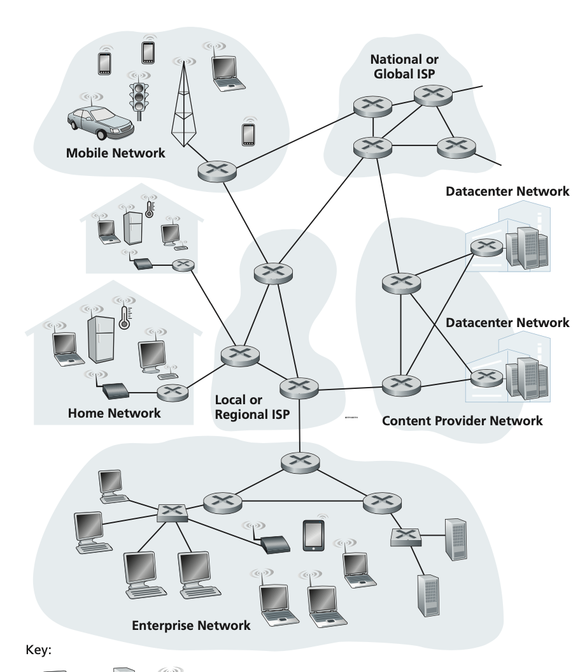
ICS 第 0.0.0.13 次小班课
Fall 2023, Dec 13th, 2023
L13: Network

Slide 2
Schedule for Today
✅ Review of Network Programming
回课：网络编程
🚀 A Network Tour: Starting From the Thin Waist
从网络栈的“细腰”出发谈网络
📝 Exercises
巩固练习
L13: Network

Slide 3
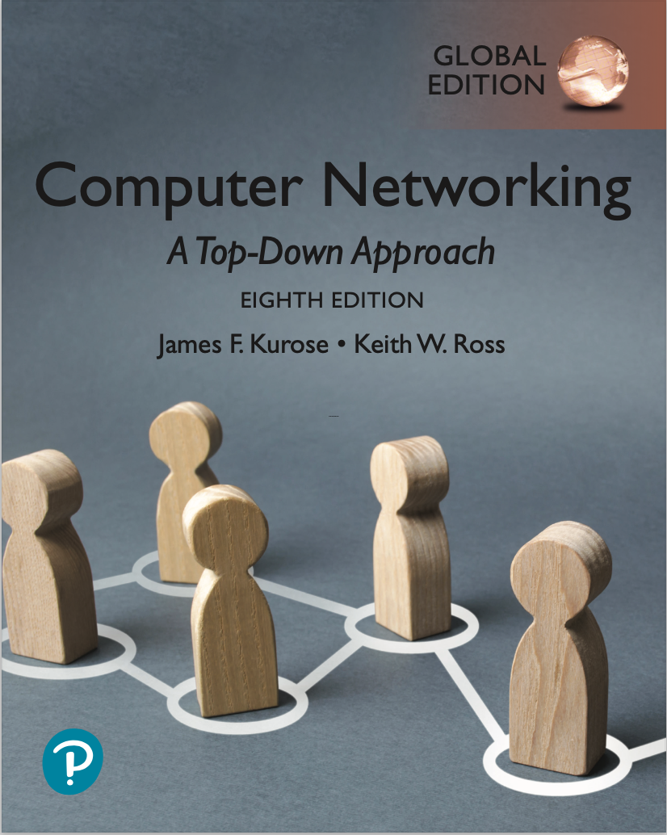
A Network Tour: Preliminaries
网络漫游
Why this tour?
There is always more to every topic in ICS. However, Chap 11 of CSAPP is probably the only chapter that leaves you aware of that.
Chap 11 focuses more on the Programming aspect of the network, i.e. how over why.
Hopefully this tour will supplement the missing big picture.
Why start from the Thin Waist?
Common practice is top-down or bottom-up.
However, starting from the thin waist means starting from a more familiar zone…
L13: Network

Slide 4
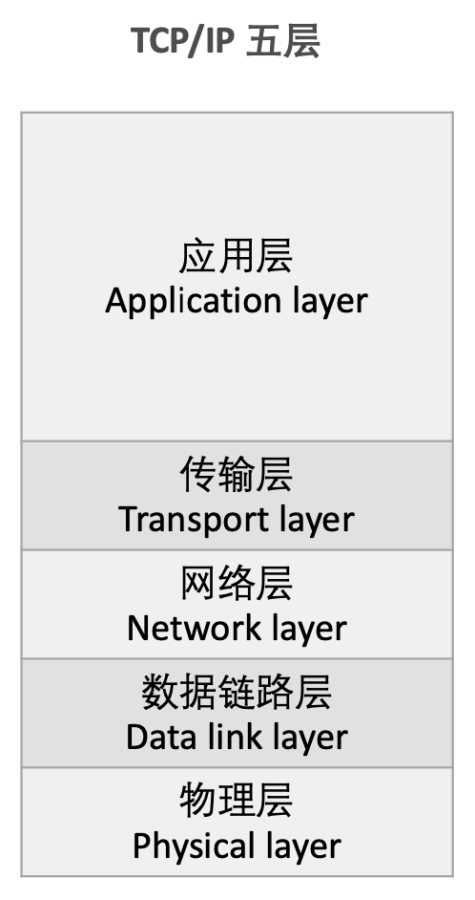
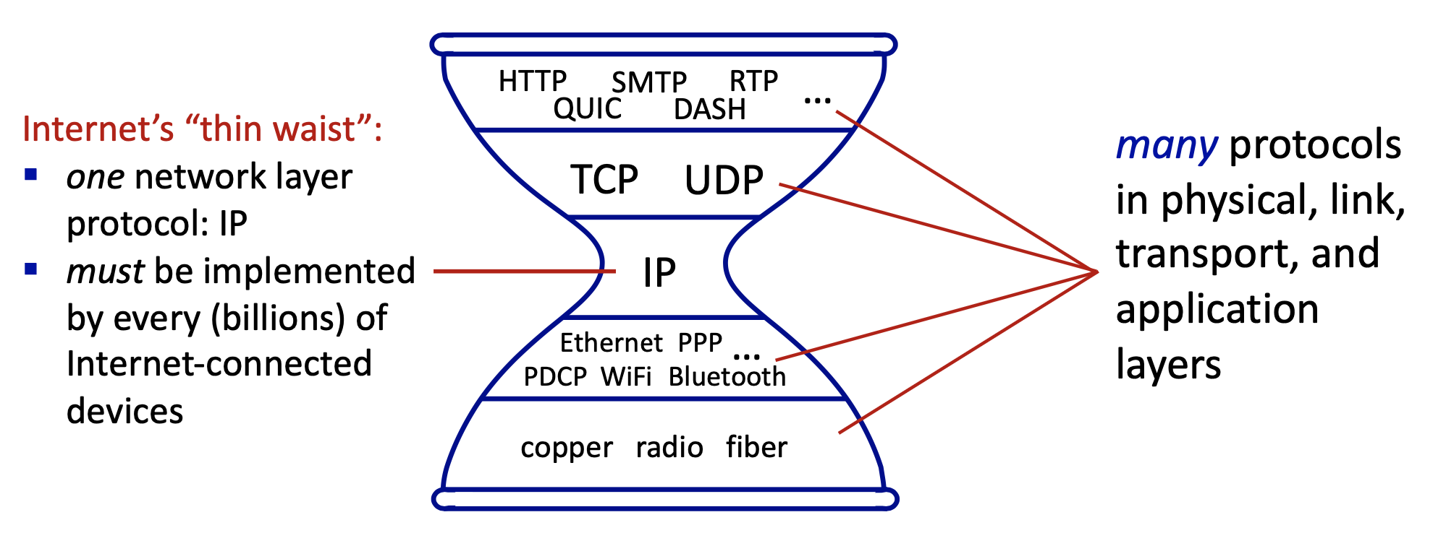
A Network Tour: Preliminaries
网络漫游
Before we start…
You should know of the concept of protocol stack, and the thin waist of it.
Network functionality is too complex to implement all at once.
The industry takes the classical layered approach.
L13: Network

Slide 5
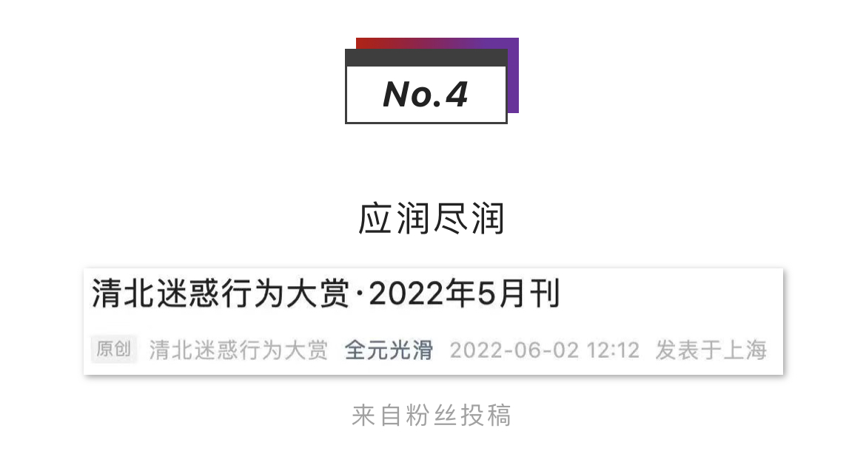
A Network Tour: Starting from IP
网络漫游：从IP开始
It is unlikely that you have never heard of IP/IP address (or jokes about it).
google.cn
4.3.2.1?
Some other PC?
Your PC
1.2.3.4
But what do you actually know about IP, beside that you seem to be able to find stuff on the Internet with an IP address?
And do you conceptualize the network as the graph above, where each node is labeled with an IP address?
L13: Network

Slide 6
A Network Tour: Network Layer
网络漫游：网络层
The first point is actually accurate: IP address is for locating things in a network.
IP is the thin waist, because we generally need only one way of addressing.
IP (Internet Protocol) is a network layer protocol. It specifies how network interfaces in a network are addressed, and how said addresses can be reached via routing.
google.cn
4.3.2.1?
However, the graph view on the right needs a few tweaks to be right…
Some other PC?
Your PC
1.2.3.4
L13: Network

Slide 7
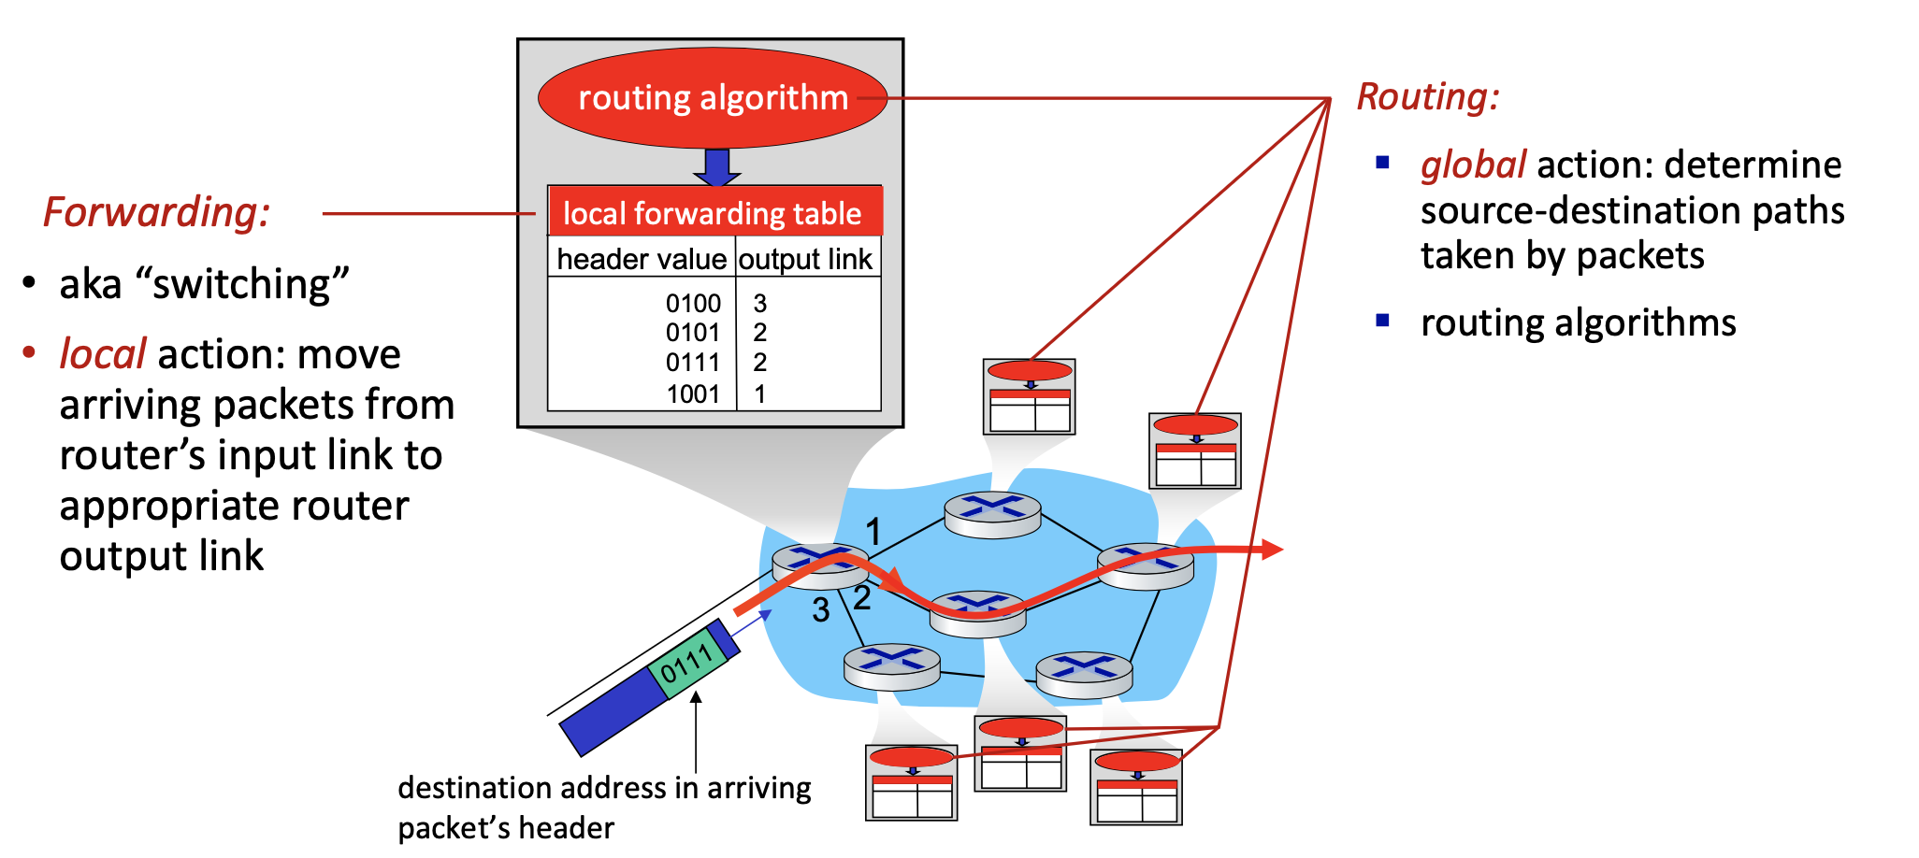
A Network Tour: Network Layer
网络漫游：网络层
A. Routers & Hosts
Internet is not just computers on a graph. Most of the nodes are in fact routers running routing algorithm for reachability, while hosts operate at endpoints.
Think of your wireless router at home, and your phones/laptops as hosts!
Routers run routing algorithms to obtain routing tables. Think of it like “IP x to port y” entries.
2. And they forward incoming packets according to the table, with a buffer.
L13: Network

Slide 8
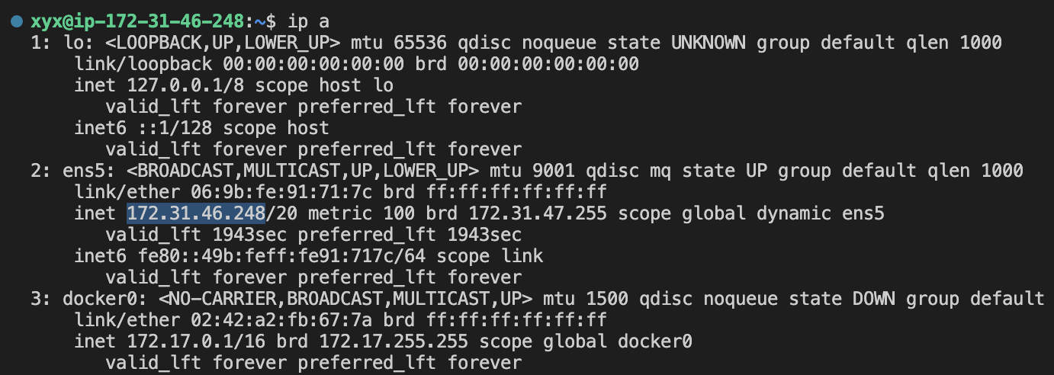
A Network Tour: Network Layer
网络漫游：网络层
B. IP Addressing (1)
IP specifies how network interfaces in a network are addressed…
Try ip a in a Linux terminal (a is short for address):
the loopback device
Interface ID: Name
IP Address
L13: Network

Slide 9
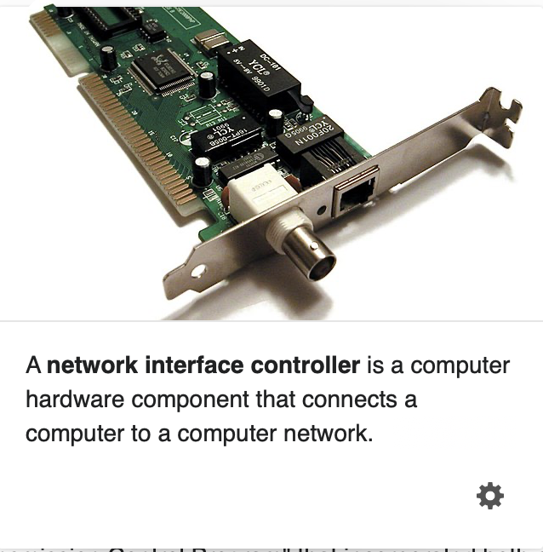
A Network Tour: Network Layer
网络漫游：网络层
B. IP Addressing (1)
To be precise, IP addresses NICs, not computers/nodes/hosts…
It is perfectly fine for a host/router to have multiple NICs, and thus have multiple IP addresses.
So the graph is more like:
NIC2 4.3.1.2
NIC1 4.3.2.1
google.cn
NIC2 1.2.2.3
NIC1 1.2.3.4
router
IP->node can be many-to-one.
Can it be one-to-many?
Your PC
L13: Network

Slide 10
A Network Tour: Network Layer
网络漫游：网络层
B. IP Addressing (3): Subnets, Classful & CIDR
Take this IP: 172.31.46.248/20. Why is it dotted, and what is the slash(/)?
Subnets
The slash(/) means a subnet mask.
172.31.46.248/20 means the leftmost 20 bits describe a subnet. The remaining 12 bits specify a host.
L13: Network

Slide 11
A Network Tour: Network Layer
网络漫游：网络层
Why Subnets?
To give the network some structure – for routers!
(The routing table need not contain all IP addresses, only subnets. Routing tables can be really large…)
Enables private networks and public networks.
Certain subnets are reserved for private assignment. In fact, the IP you see with hostname –i is most likely private.
IP addresses can be reused across private networks. This helps with the IPv4 depletion problem (more on that later).
L13: Network

Slide 12
A Network Tour: Network Layer
网络漫游：网络层
Classful IP Addressing
L13: Network

Slide 13
A Network Tour: Network Layer
网络漫游：网络层
Other Special IP Addresses
L13: Network

Slide 14
A Network Tour: Network Layer
网络漫游：网络层
CIDR Addressing
IPv4, IPv6 and IP address depletion
IPv4 addresses (32-bit) have been depleted in February 2011. IPv6 (128-bit), despite being over 20-year-old and offering more addresses, is still not quite here because of its tricky differences.
The only way Internet is still growing, and what enables YOU to launch random Linux VMs that also have IP addresses, is to reuse private IP addresses.
Being private, your VM’s IP address is only reachable within your LAN (you cannot make it a public server), and your classmate’s VM IP can be exactly the same as yours.
Wonder how your VM connects to the Internet anyway?
L13: Network

Slide 15
A Network Tour: Network Layer
网络漫游：网络层
B. IP Addressing (4): IP Configuration*
General idea: IP addresses are always assigned.
Public Internet is maintained by ISPs (Internet Service Provider, for example China Mobile). They set up routers and their IPs, and sell you routers with assigned IP addresses.
Private addresses, then, are managed by enterprises/yourself however they want. When Wi-Fi is enabled on your PC, it uses DHCP (Dynamic Host Configuration Protocol) to contact your wireless router and then a DHCP server, which leases a private IP to you.
To bridge between private and public, there is NAT (Network Address Translation).
Basically, all out-going private traffic takes the one public IP address that you bought from the ISP, and in-going traffic is redirected to their local IP destinations. Read for more on Wiki!
lease
timeout!
L13: Network

Slide 16
A Network Tour: Network Layer
网络漫游：网络层
A Final Case Study
The 192.xx.xx.xx IP is private, assigned by the network you are connect to.
The 111.205.240.27 is probably owned by PKU, bought and assigned from ISP. In this case, you are connected to a wireless AP (Access Point) on campus.
The 223.104.39.154 is assigned from another ISP, that you paid for your 4G/5G service. It is probably the IP of the base station your cell phone is talking to.
The VPN is another whole mess (and fun ☺). In a nutshell, you talk to proxy servers via IPSEC (secure IP protocol, that sets up tunnels from you to the proxy). The tunnel is encrypted, so it only looks as if the proxy is accessing the network for you.
The public IPs are maintained by ISPs, and they know the physical locations.
L13: Network

Slide 17
A Network Tour: Down to Link Layer
网络漫游：链路层
By far we only talked about the Network Layer, i.e. how to locate stuff.
Maybe you are already overwhelmed. Please collect yourself, because I’m not going into too much details for the following layers…
Looking down, there remain two problems: (a) how to format the data sent in the network, and (b) how the data is actually sent. The link layer tackles (a), and the physical layer tackles (b).
Still not Accurate Enough ->
NIC2 4.3.1.2
What do we do with the data when we put messages onto NIC?
How does NIC actually send out data?
Is there only routers in between?
NIC1 4.3.2.1
google.cn
NIC2 1.2.2.3
NIC1 1.2.3.4
router
L13: Network

Slide 18
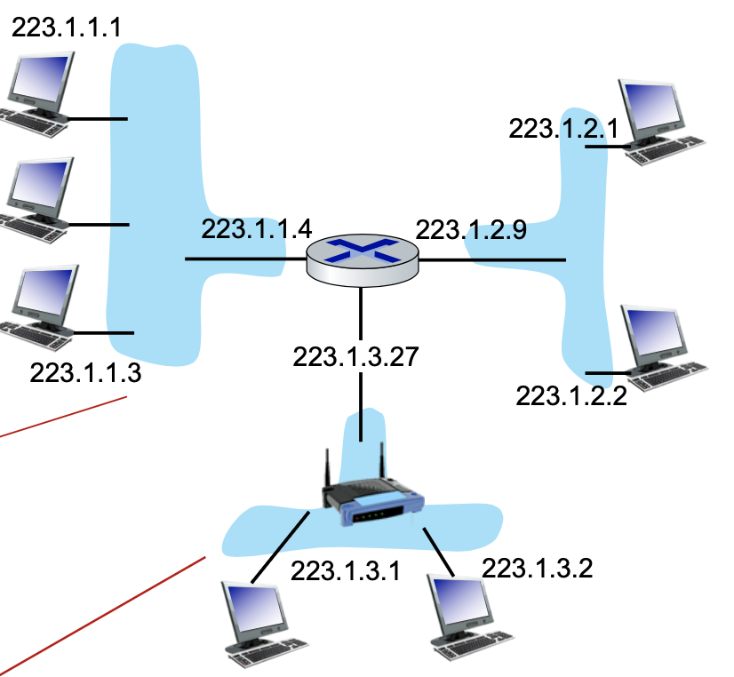
A Network Tour: Down to Link Layer
网络漫游：链路层
Two Exemplar Link Layer Protocols
Ethernet. This is for wired networks. It specifies an MTU (Maximum Transmission Unit, i.e. the maximum packet size), which has some funny outdated relation with the latency and bandwidth of old wires.
802.11, or Wi-Fi. This is for wireless networks. Wireless is a more challenging setting, and the protocol specifies error detection and correction (because of noise), data compression (because of limited bandwidth), and encryption (because it’s broadcast).
Hopefully this shows the necessity of link layer protocols. Sending raw data is not viable in lower layers, especially when the actual medium is noisy/restrictive.
Ethernet
802.11
L13: Network

Slide 19
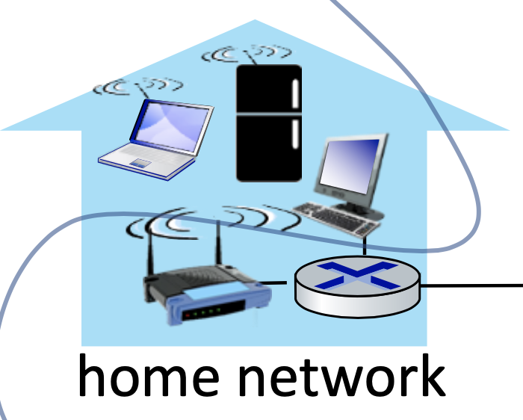
A Network Tour: Down to Link Layer
网络漫游：链路层
MAC Address
In a Wi-Fi network, MAC addresses specify source and destination devices.
CSAPP P643
Besides an IP address, each NIC also has a 48-bit MAC address in its ROM, also known as the physical address.
These MAC addresses are globally unique, and are not changed.*
Why both MAC address and IP address?
I guess everyone faces this problem when they learn about both addresses. Here is a short answer: The MAC address (unique) is for identifying who you are, while the IP address (structured and assigned) tells about how to find you.
*: There is still a but. You can search for it yourself.
L13: Network

Slide 20
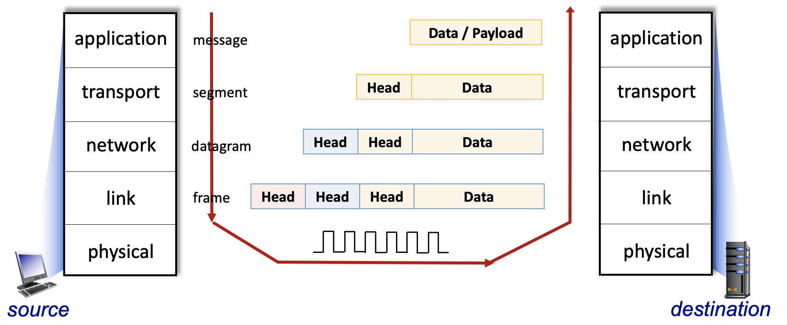
A Network Tour: Down to Link Layer
网络漫游：链路层
Encapsulation
We should note that all protocols discussed by far will add headers to their payload.
L13: Network

Slide 21
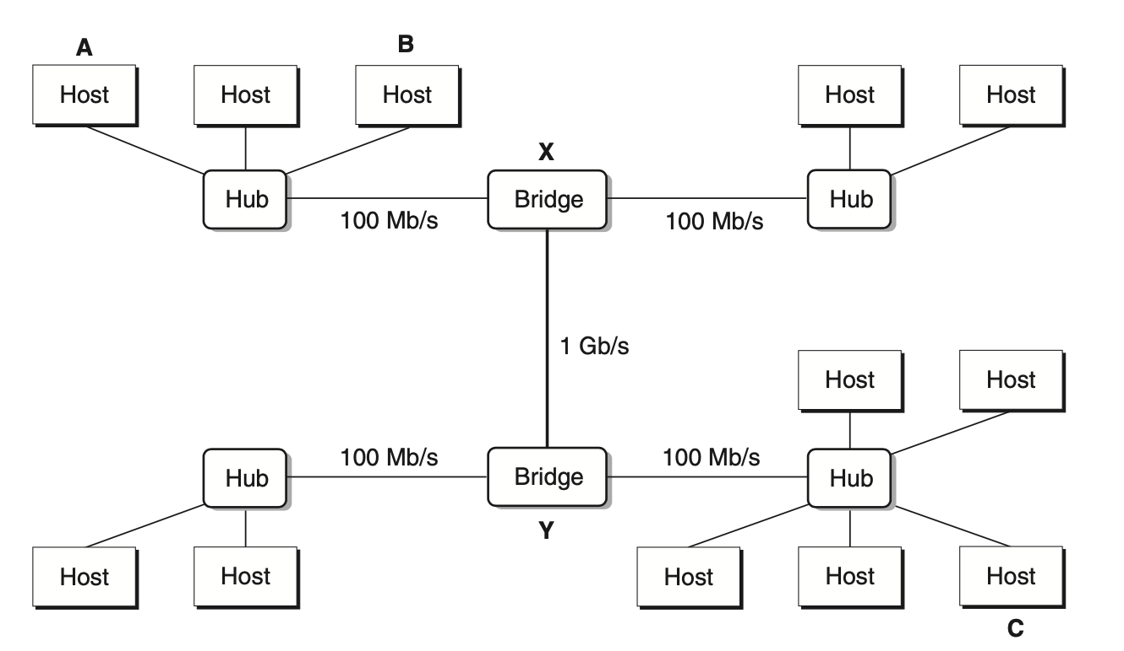
A Network Tour: Down to Link Layer
网络漫游：链路层
Encapsulation & Switch / Router
Encapsulation helps separate the layers, and bridge between different networks.
A bridge is not a router.
Bridges/switches operate at the link layer.
They also build a forwarding table, not by routing algorithms, but with a special memory/broadcasting scheme, using MAC addresses.
They do not scale very well, and are used only for connecting a LAN.
Net
Net
Link
Link
Link
Link
Phys
Phys
Switch
Phys
Phys
Router
L13: Network

Slide 22
A Network Tour: Down to Link Layer
网络漫游：链路层
L13: Network

Slide 23
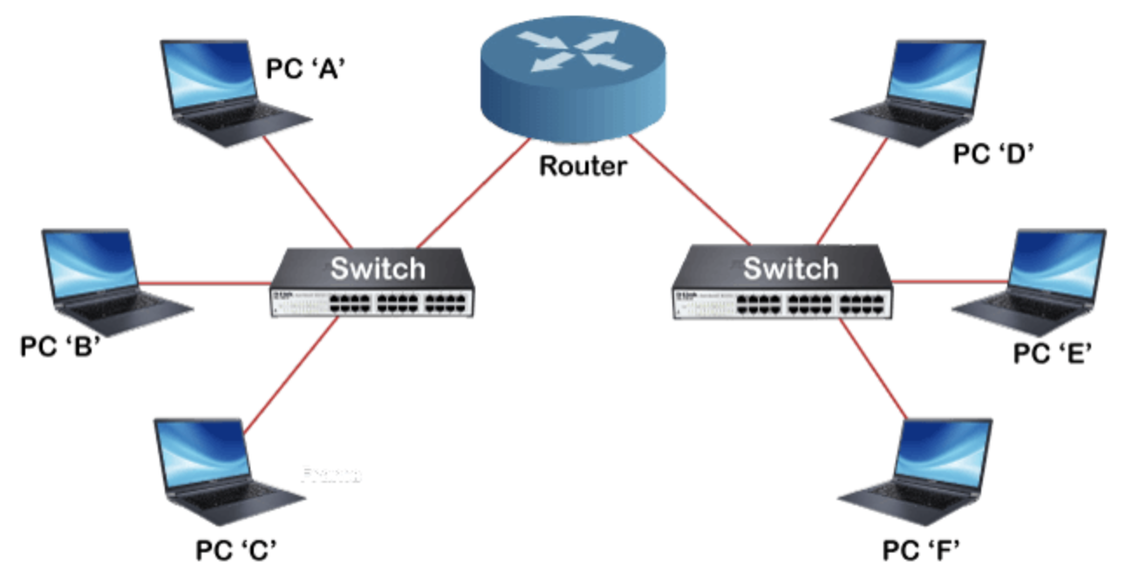
A Network Tour: Down to Link Layer
网络漫游：链路层
Switch / Router
Question: How many subnets are there in the figure?
L13: Network

Slide 24
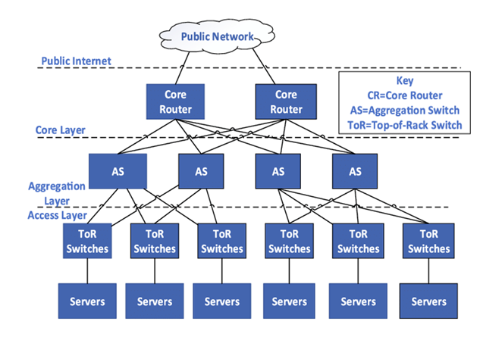
A Network Tour: Down to Link Layer
网络漫游：链路层
Switch / Router in Real Data Center Networks
L13: Network

Slide 25
A Network Tour: Physical Layer
网络漫游：物理层
As the bottom layer, the physical layer is about how data is actually sent.
We are working with hardware and the physical world now. We care about fiber, copper wire, radio and their physical properties to design hardware encoders and decoders.
Still, this is more than materials. For example, we use the Fourier transform to robustly encode information with sine waves. We design algorithms to avoid conflicts, or de-noise antenna array signals. Mathematics is also CS. How fun.
L13: Network

Slide 26
A Network Tour: Physical Layer
网络漫游：物理层
Hub
A hub operates in the physical layer, and it is nothing magical. Just think about a bunch of wires connected together.
Net
Net
Link
Link
Link
Link
Phys
Phys
Phys
Phys
Phys
Phys
Hub
Switch
Router
L13: Network

Slide 27
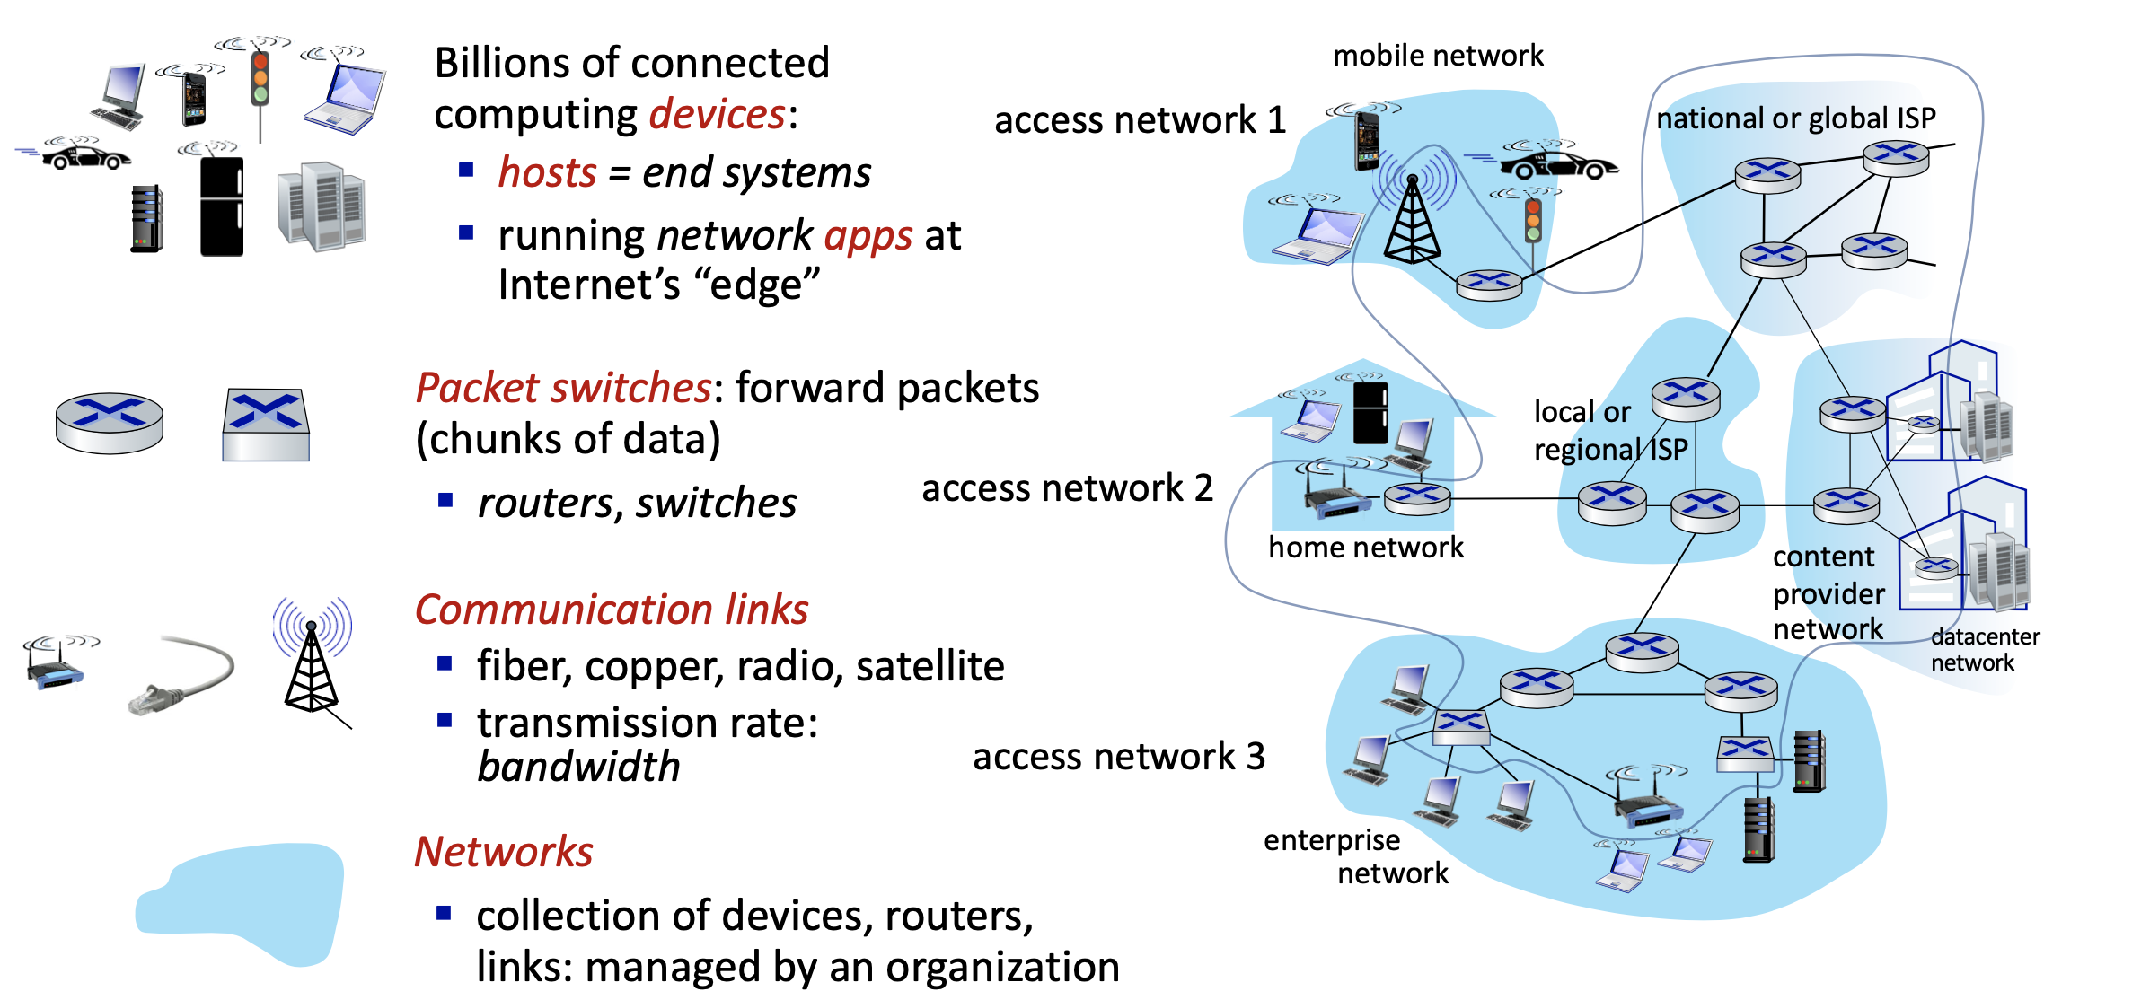
A Network Tour: A Recap
网络漫游：中场回顾
We have now toured the lower half of the protocol stack. Note that we already have a working network that provides best-effort delivery.
Much more accurate than the graph in the beginning...
L13: Network

Slide 28
A Network Tour: Transport Layer
网络漫游：传输层
Why the transport layer, and what does it include?
The (raw) IP interface is not very programmer-friendly…
And it is only best-effort delivery, not reliable.
Why is IP not reliable?
You may think of the dynamic topology of the network, or the lossy links (like the wireless settings).
These can lead to loss of packets. However, another (and probably dominant) factor is buffering in switches and routers.
Suppose a switch/router is forwarding multiple flows to one out-link. The speed of the out-link will not keep up, and the switch/router must buffer the packets, but not endlessly. When the buffer is full, newer packets are simply discarded.
We need a programmer friendly interface with multiplexing (multiple applications can use the network simultaneously).
And reliable delivery!
L13: Network

Slide 29
A Network Tour: Transport Layer
网络漫游：传输层
Socket: The Interface
Network sockets are merely an interface invention. It combines an IP address with a port, with the port number providing the multiplexing functionality.
Processes use sockets as endpoints of network data transmission.
In Linux, the socket is actually a general abstraction above multiple transport layer protocols, and appears to be a file descriptor.
Both TCP and UDP have ports and sockets. The SOCK_STREAM type in socket() means TCP, but there is also one for UDP.
L13: Network

Slide 30
A Network Tour: Transport Layer
网络漫游：传输层
TCP: The Reliability
The TCP (Transmission Control Protocol) is the prominent reliable data transport protocol nowadays. Bit of a monstrosity itself; details are omitted.
TCP is connection-oriented. All TCP sessions start with a connection setup.
Reasons why this matters are also a bit involved. Simply put, a connection is needed for reliability and flow control. Moreover, the underlying network are actually optimized for these flows.
There is also the UDP (User Datagram Protocol), that gives no reliability guarantee, and is connectionless. It is basically the raw IP with sockets on top.
Why both UDP and TCP?
UDP includes the usability from “interface,” but not the possible overhead from “reliability.” Certain apps may use UDP for the lesser overhead, like voice chatting where latency matters.
L13: Network

Slide 31
A Network Tour: Transport Layer
网络漫游：传输层
Programming Over the Transport Layer
As is mentioned, the Linux network programming interface is a POSIX interface that sits on top of any transport layer protocols. Everything below is kernel code.
L13: Network

Slide 32
A Network Tour: Application Layer
网络漫游：应用层
Why the Application Layer?
What TCP provides is merely a reliable two-way byte stream. We still need to:
Decide how to make sense of the data sent and received.
TCP is especially tricky for it does not guarantee any boundary within the stream. One message sent may be split into two when received, so structuring the data is very much needed.
Exemplar Application Protocols: HTTP, SFTP, IMAP… These all use TCP, but there are also protocols over UDP, like RTP (Realtime-Transport Protocol).
This is why HTTP specifies a clear header, and \r\n to separate lines.
L13: Network

Slide 33
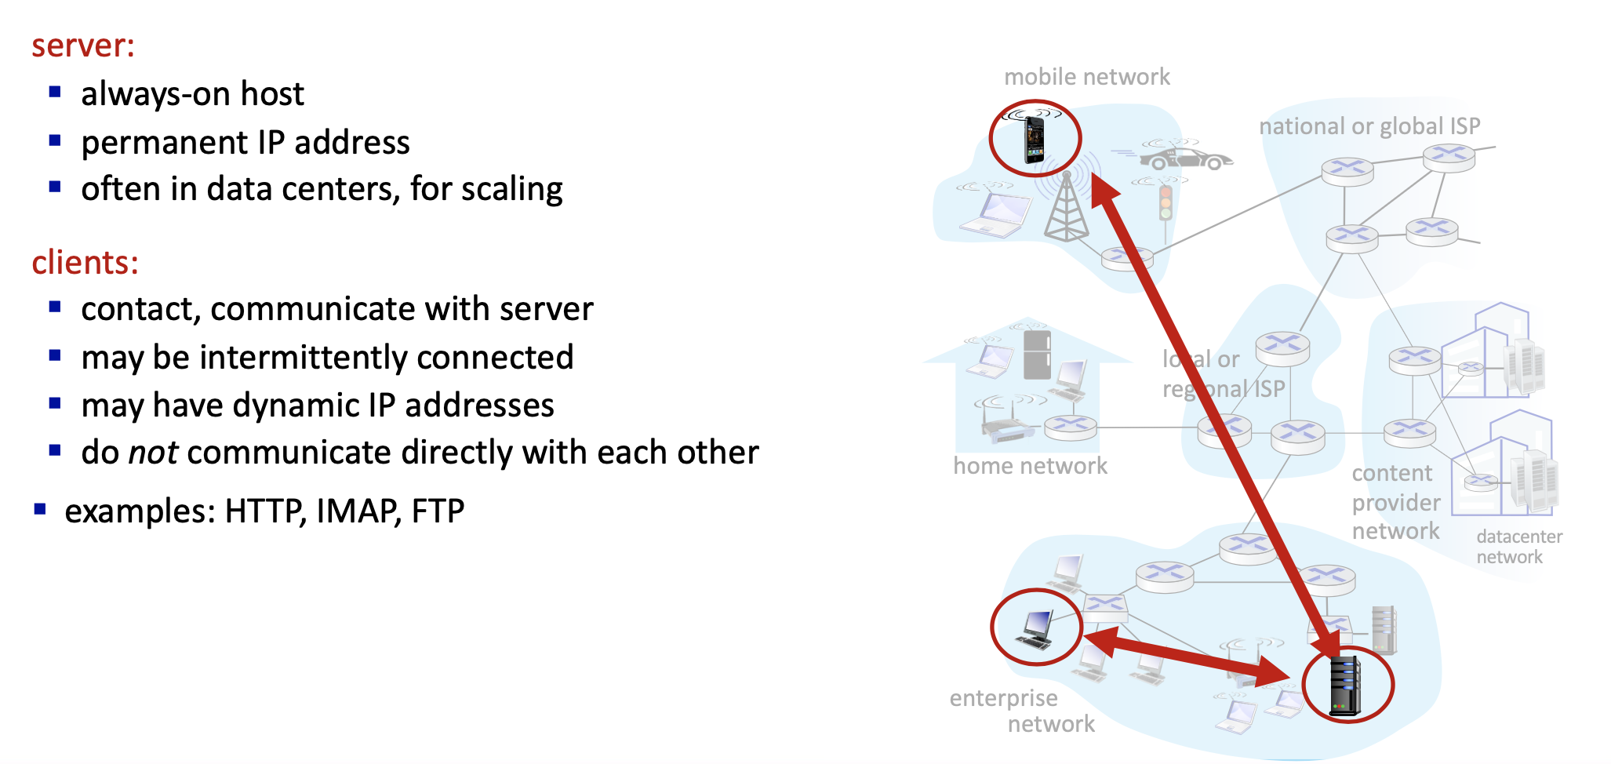
A Network Tour: Application Layer
网络漫游：应用层
Client-Server Paradigm
L13: Network

Slide 34
A Network Tour: Application Layer
网络漫游：应用层
HTTP
HTTP (Hyper Text Transfer Protocol) is typically used to transfer web contents.
L13: Network

Slide 35
A Network Tour: Application Layer
网络漫游：应用层
L13: Network

Slide 36
A Network Tour: Application Layer
网络漫游：应用层
L13: Network

Slide 37
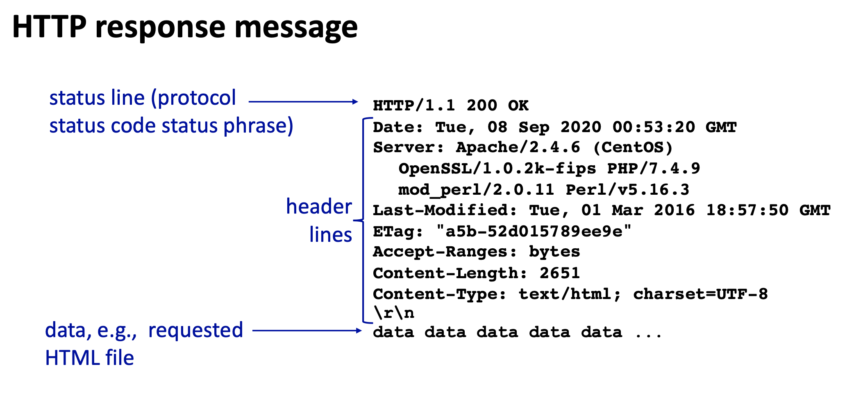
A Network Tour: Application Layer
网络漫游：应用层
What you need to do in the proxylab is to relay these HTTP requests and responses, plus some caching.
L13: Network

Slide 38
A Network Tour: Application Layer
网络漫游：应用层
L13: Network

Slide 39
A Network Tour: Application Layer
网络漫游：应用层
DNS
DNS (Domain Name System) translates domain names into IP addresses.
Domain names are separated by dots(.), and are traversed backwards.
E.g. pku.edu.cn is firstly a part of .cn; then .edu.; then .pku.
Each level corresponds to a set of DNS servers that provide the resolution service. DNS servers in PKU are responsible for xxx.pku.edu.cn.
DNS actually provides interesting opportunities. In fact, the name-to-IP mapping may be one-to-many, especially with popular contents (like the Bilibili video database). Basically, the content is copied to multiple places (and IPs), and the DNS server gets to pick one IP that is the closest to the client / least loaded. This trick enables CDN (Content Distribution Network).
L13: Network

Slide 40
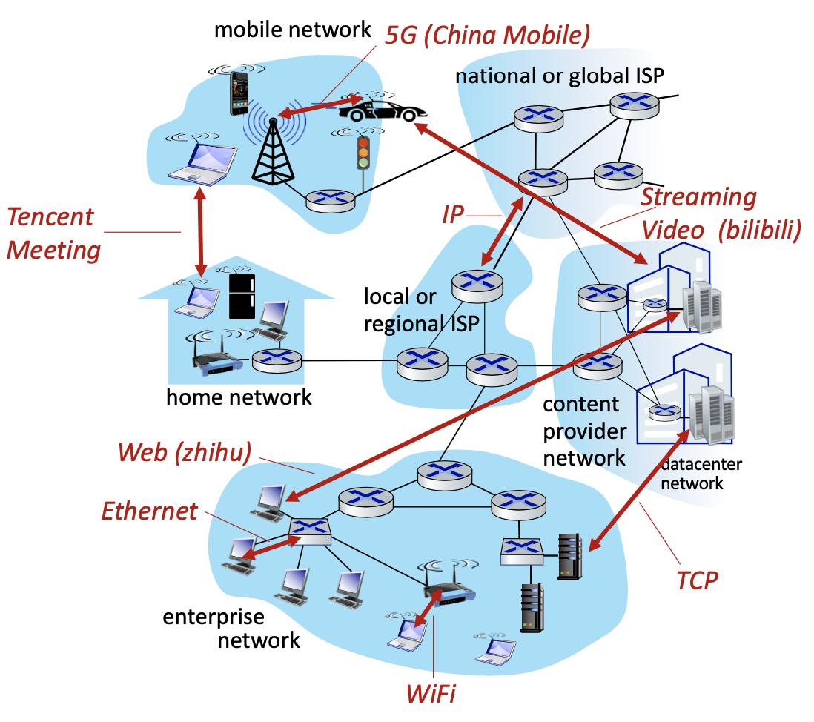
A Network Tour: A Complete View
网络漫游：完整视角
Refresh Your Conceptual View!
google.cn
4.3.2.1?
Some other PC?
Your PC
1.2.3.4
Still a lot more to learn in the Computer Network course… Alas.
L13: Network

Slide 41
Exercises
巩固练习
web内容
用户代码
数据流
内核代码(/硬件)
数据报
内核代码(/硬件)
L13: Network

Slide 42
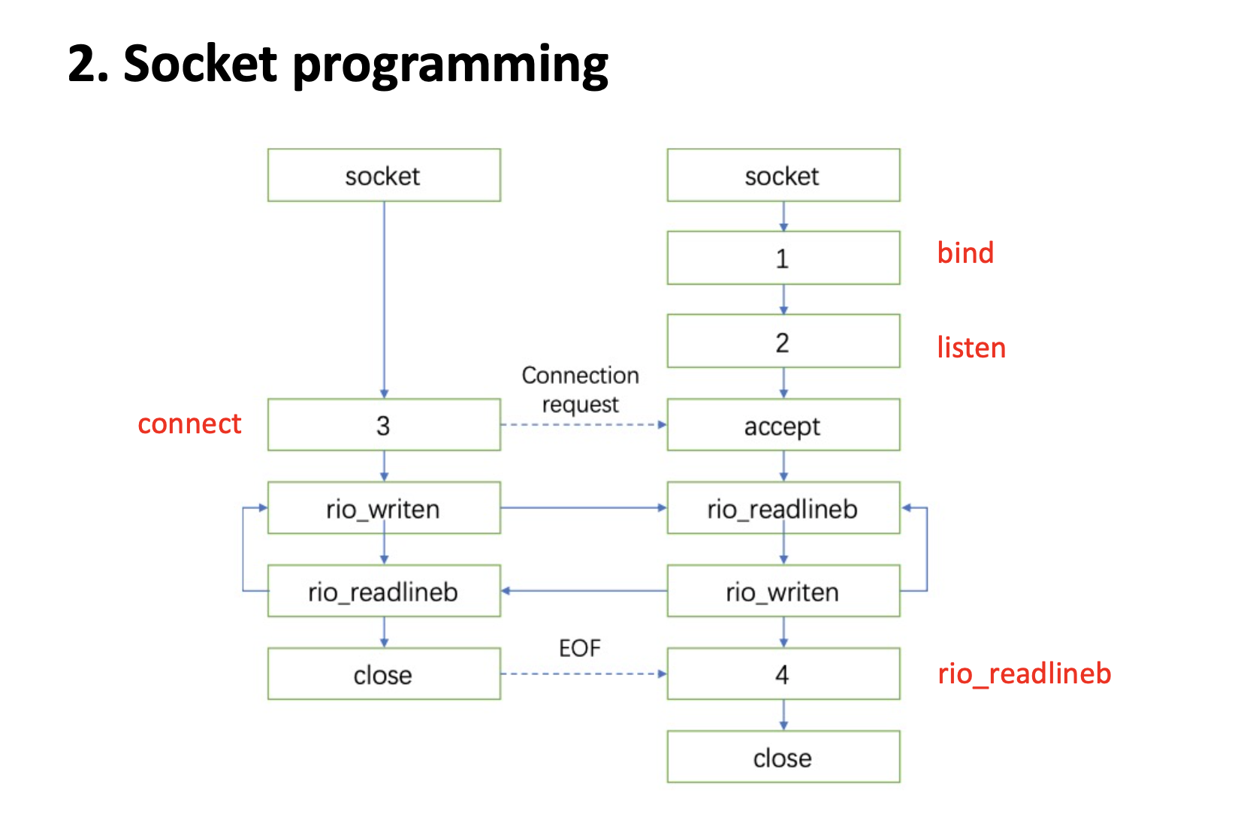
Exercises
巩固练习
L13: Network

Slide 43
Exercises
巩固练习
L13: Network

Slide 44
Exercises
巩固练习
C
A. HTTP B. TCP C. DNS D. SSL/TLS
L13: Network

Slide 45
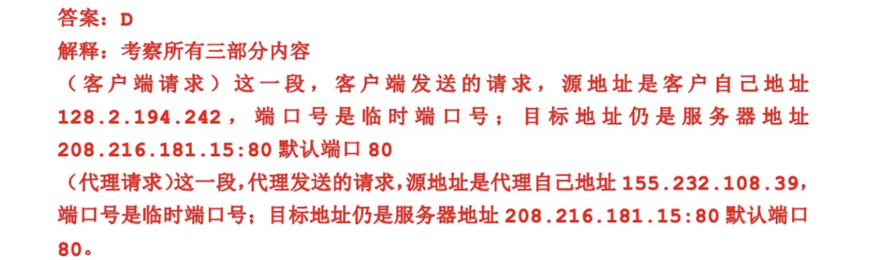
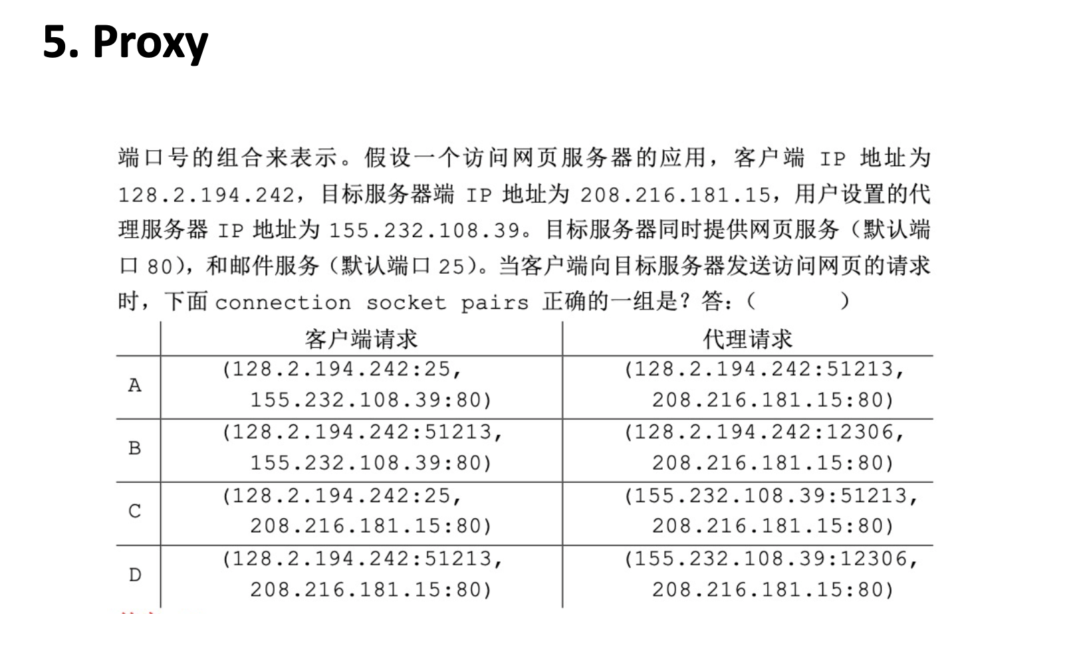
Exercises
巩固练习
L13: Network

Slide 46
Next Class…
Chapter 12: Concurrent Programming
..
Prepare for the Exam!
..
L13: Network

