Slide 1
Processor Arch: Sequential
Processor Arch: Pipelined

Slide 2
Processor Arch: Sequential

Slide 3
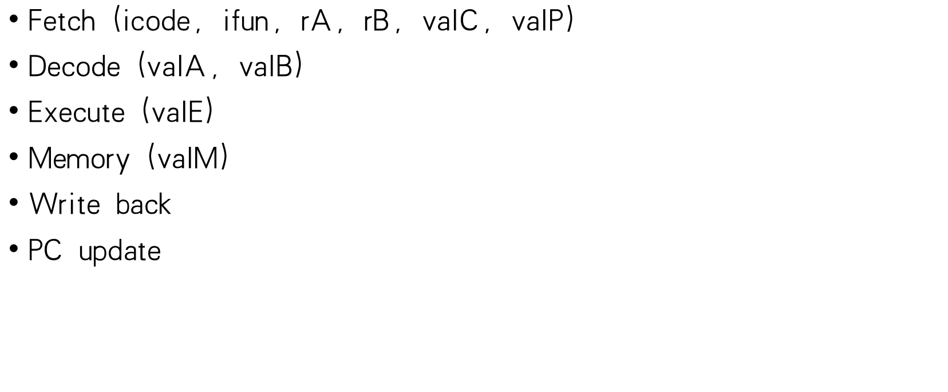
Basic Stages

Slide 4
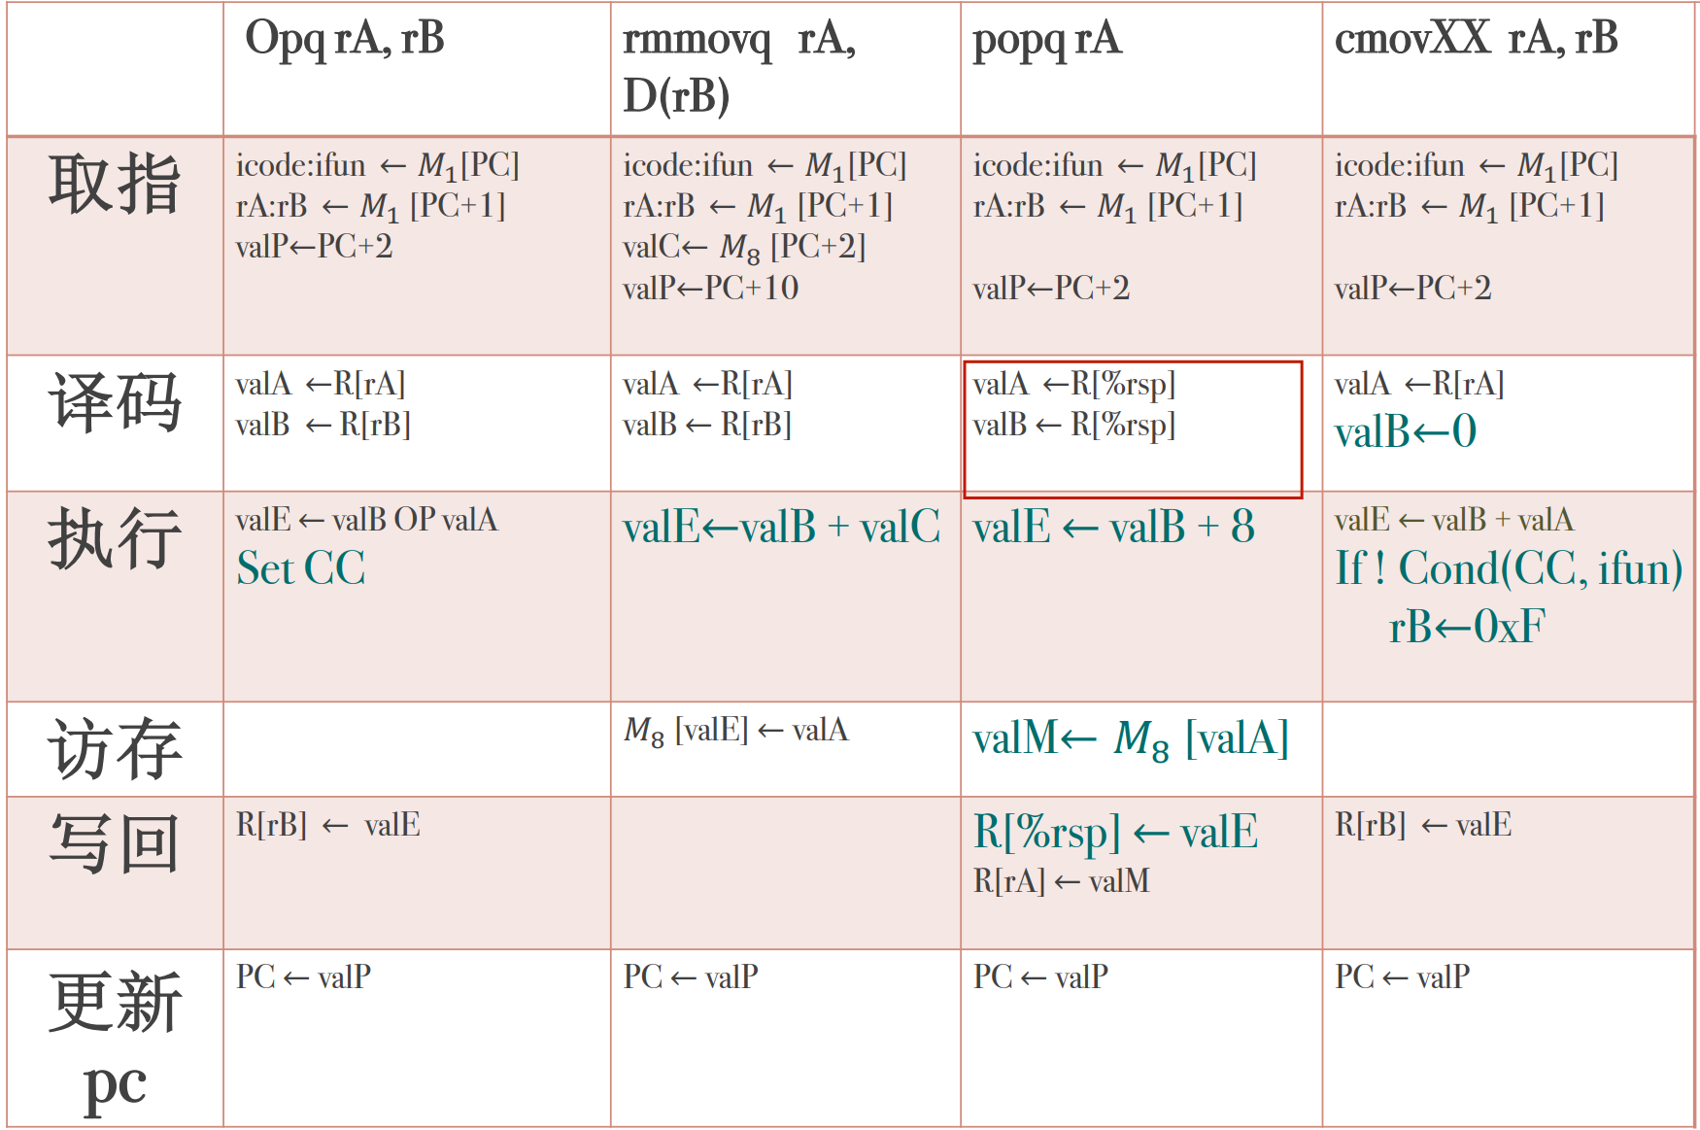
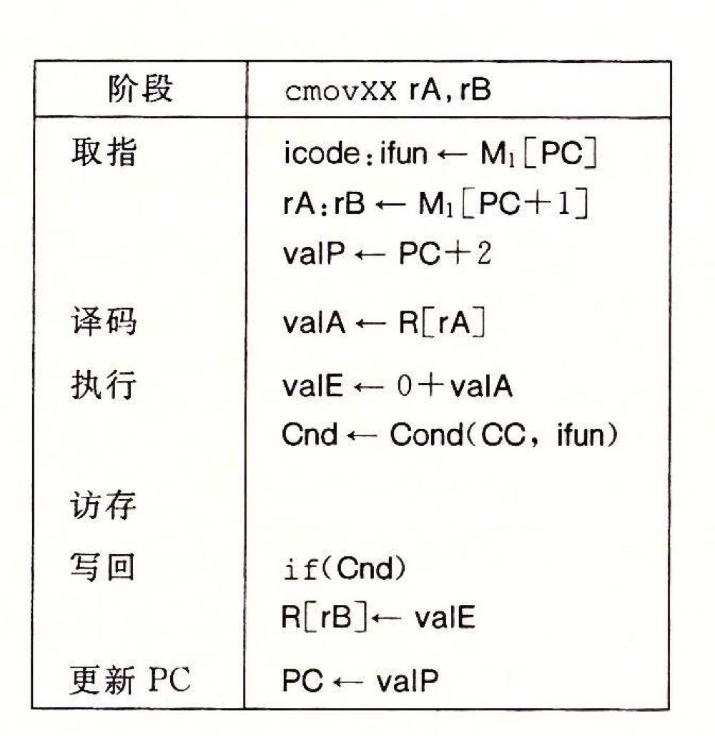
回想一下pushq？
rrmovq执行阶段？
Notes:
取指阶段判断指令长度
opq目的操作数和源操作数都是寄存，ALU还可以用来计算内存引用地址
popq：回想一下pushq
回答一下opq有哪些操作
怎么回事，书上和archlab都没有有关cmov的hcl

Slide 5
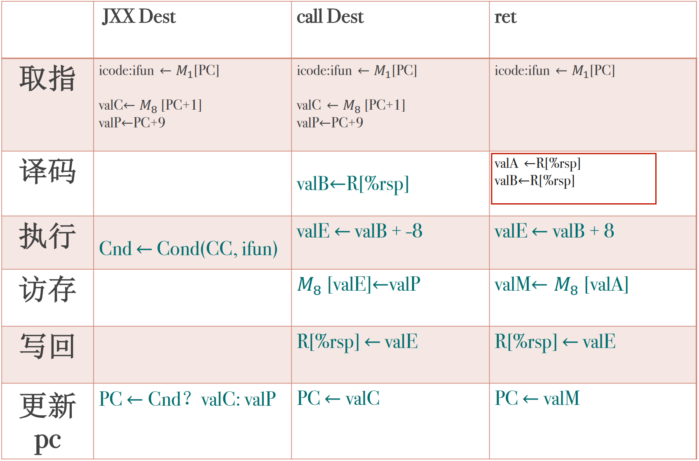
Notes:
ret没有计算valp，执行阶段总是valB？现将rsp-8然后让valE作为写操作的地址，在写之前，将栈指针-8即使栈指针的更新在内存操作之后才进行的

Slide 6
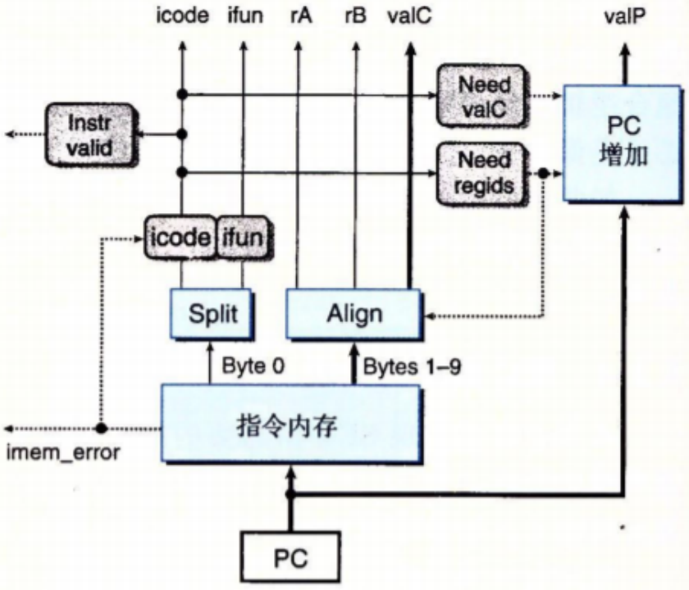
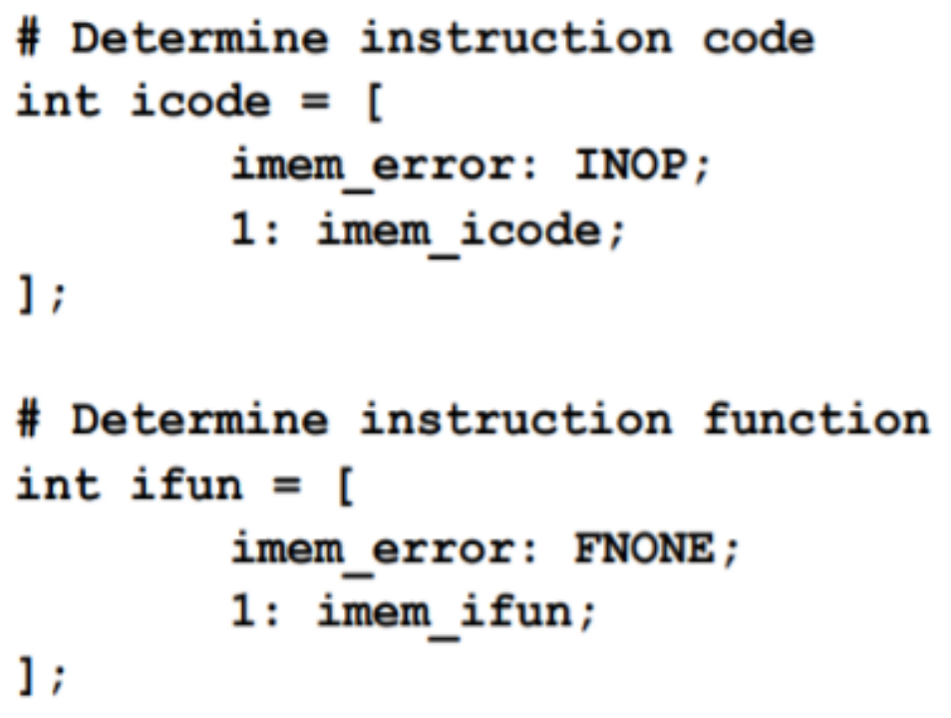
Fetch

Slide 7
Fetch

Slide 8
Fetch

Slide 9
Fetch

Slide 10
Fetch

Slide 11
Fetch

Slide 12
Decode

Slide 13
Decode

Slide 14
Decode

Slide 15
Decode

Slide 16
Decode

Slide 17
Decode

Slide 18
Decode

Slide 19
Decode

Slide 20
Decode

Slide 21
Decode

Slide 22
Decode

Slide 23
Decode

Slide 24
Decode

Slide 25
Decode

Slide 26
Decode

Slide 27
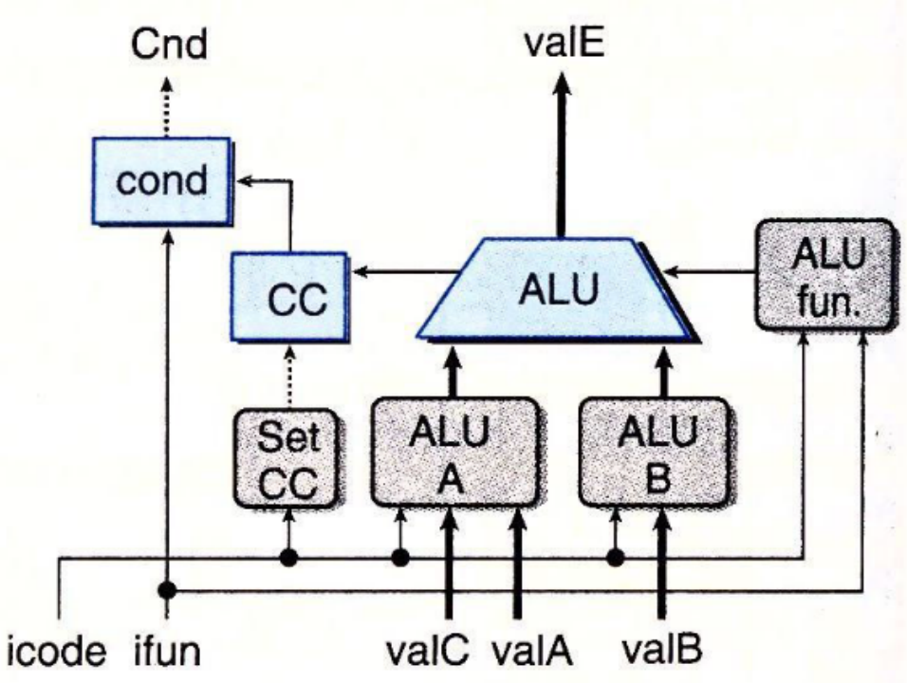
Execute

Slide 28
Execute

Slide 29
Execute

Slide 30
Execute

Slide 31
Execute

Slide 32
Execute

Slide 33
Execute

Slide 34
Execute

Slide 35
Execute

Slide 36
Execute

Slide 37
Execute

Slide 38
Execute

Slide 39
Execute

Slide 40
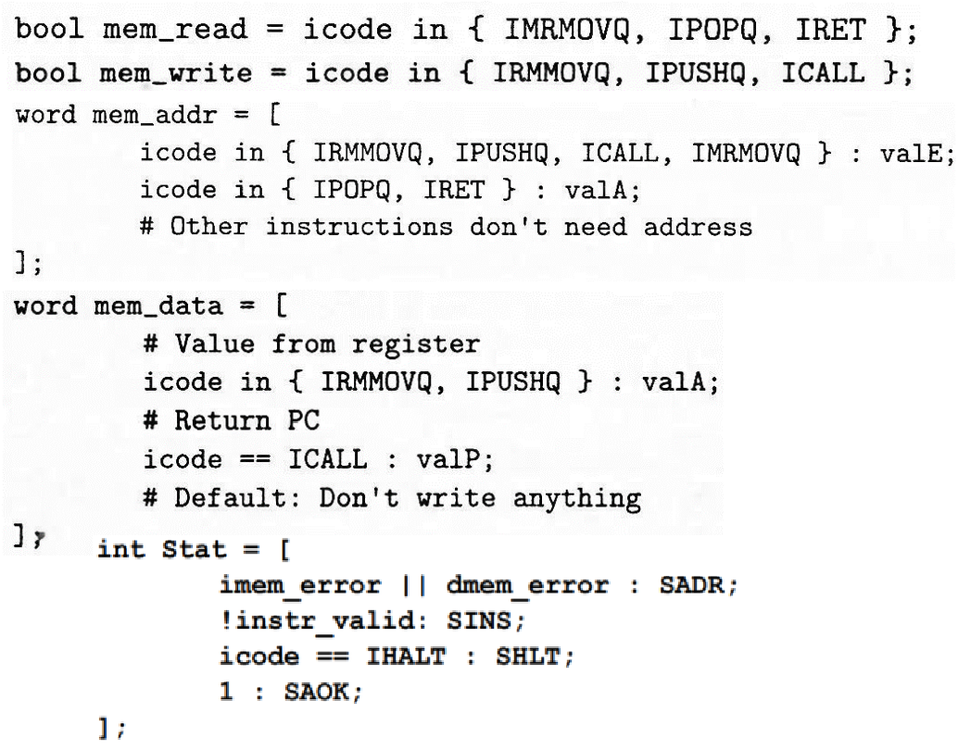
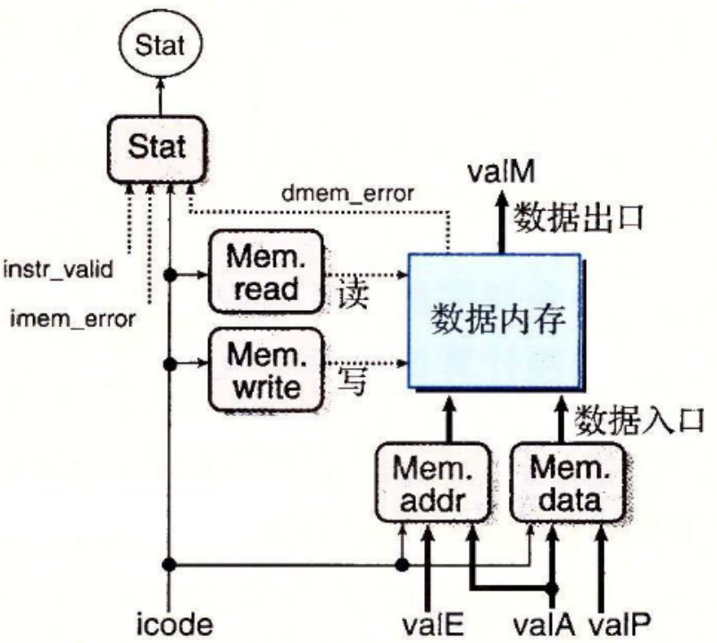
Memory

Slide 41
Memory

Slide 42
Memory

Slide 43
Memory

Slide 44
Memory

Slide 45
Memory

Slide 46
Memory

Slide 47
Memory

Slide 48
Memory

Slide 49
Memory

Slide 50
Memory

Slide 51
Memory

Slide 52
Memory

Slide 53
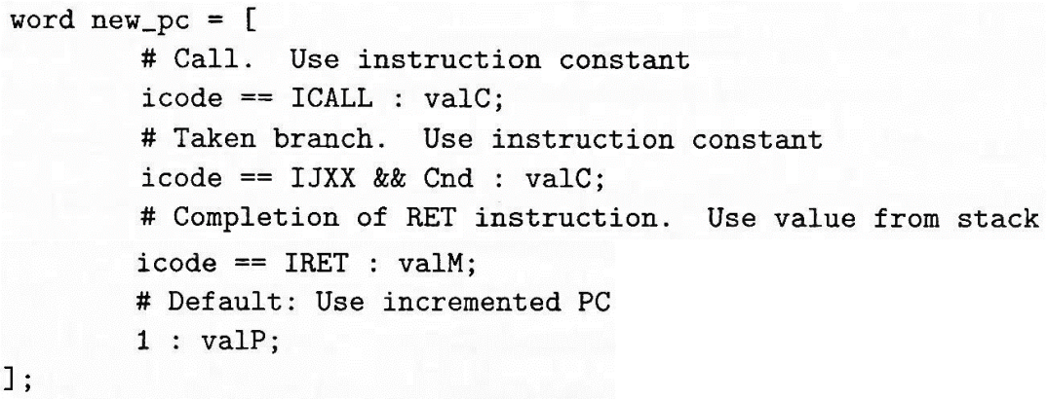
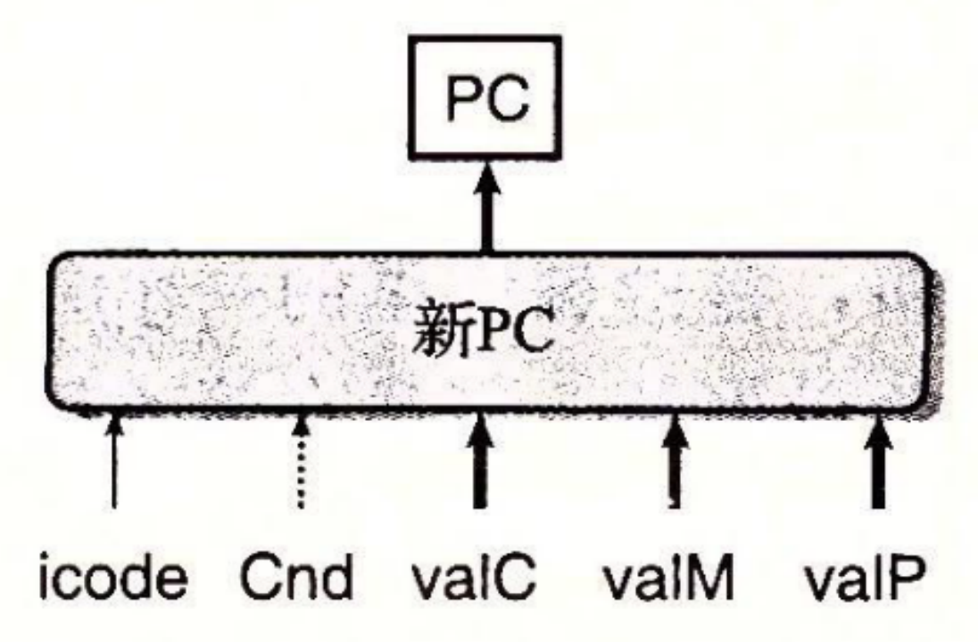
New PC

Slide 54
New PC

Slide 55
Processor Arch: Pipelined

Slide 56
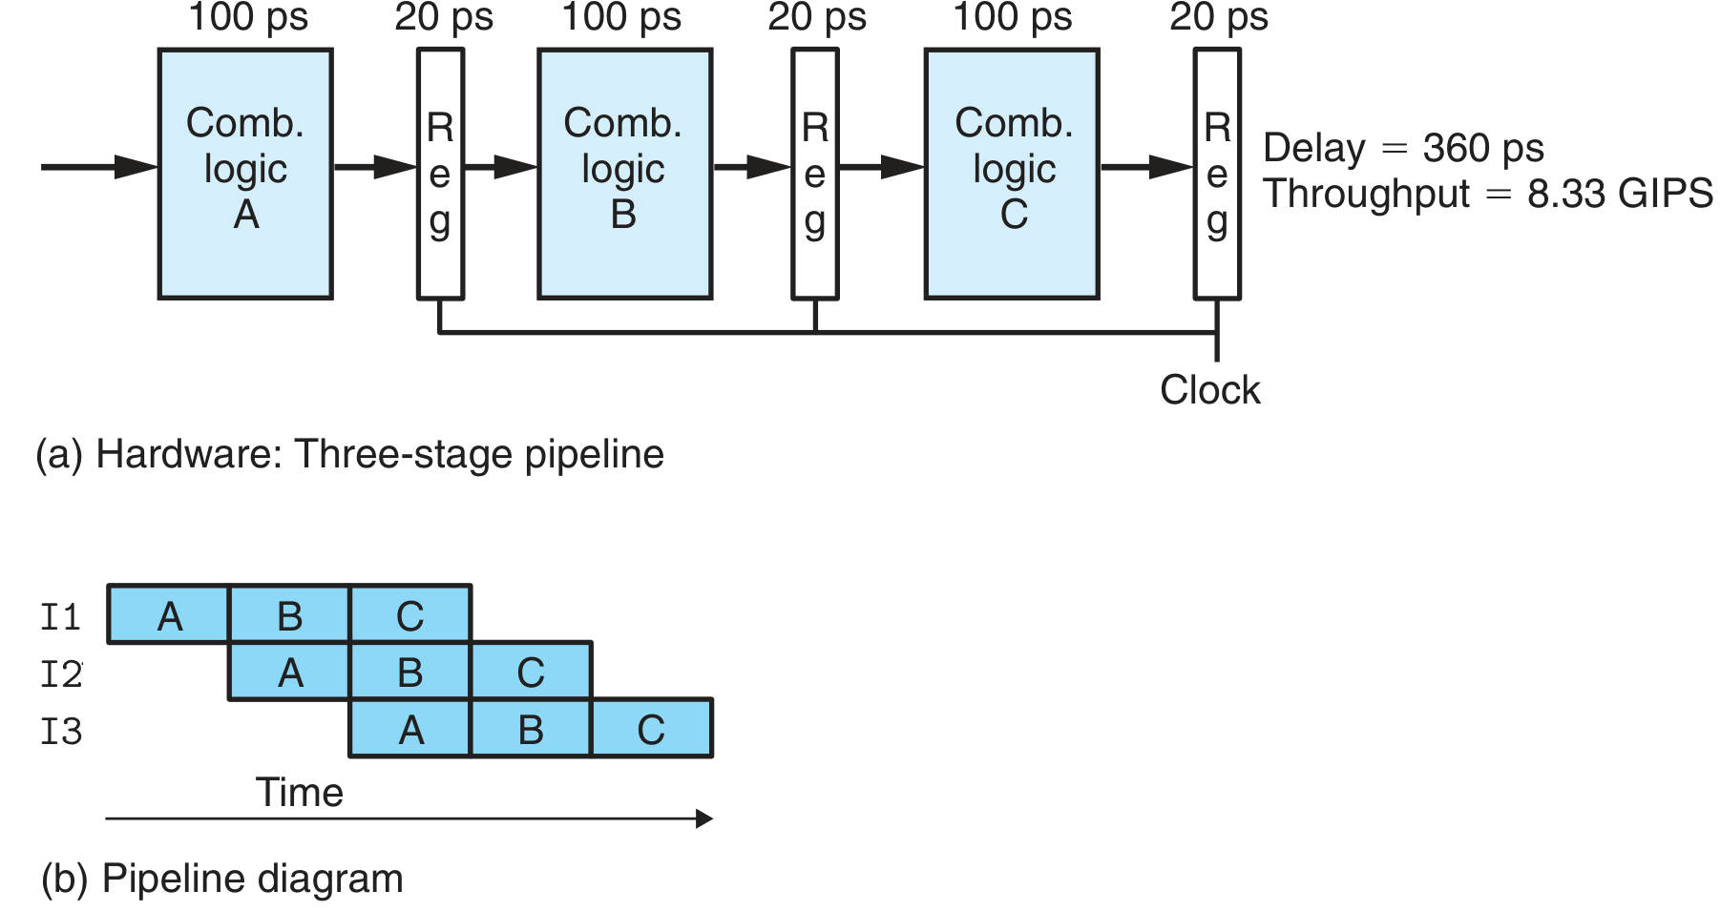
Pipeline Basics
Throughput and latency change

Slide 57
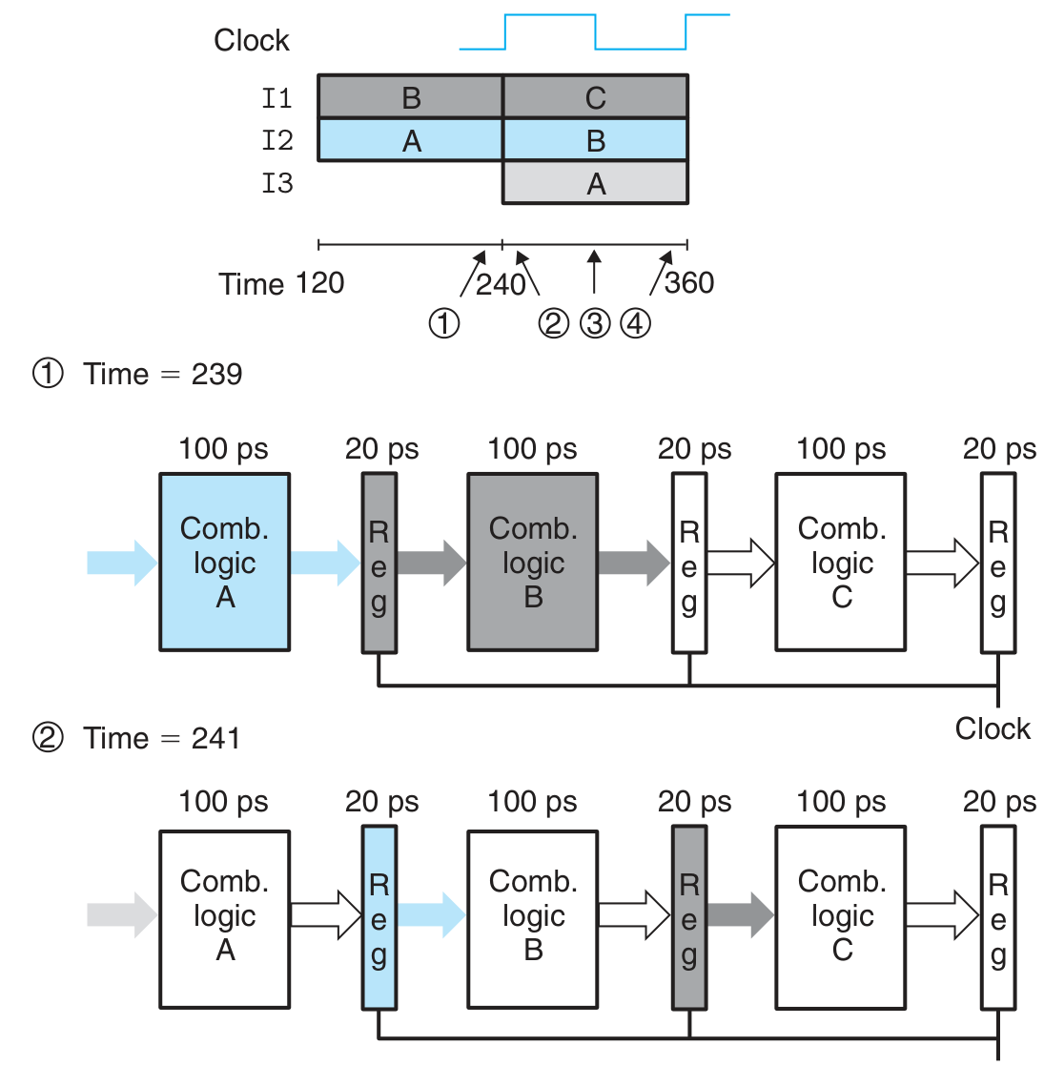
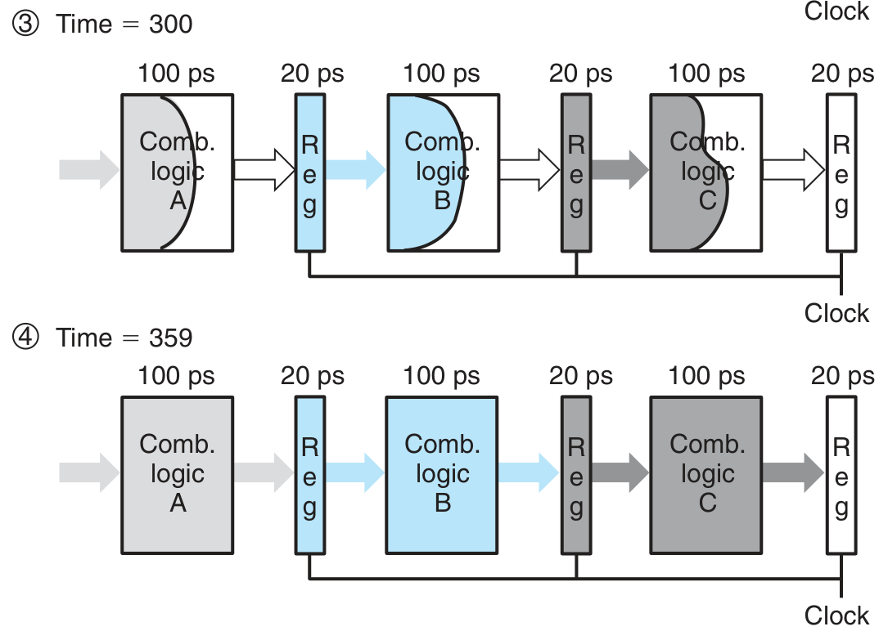
Pipeline Basics
Critical moments

Slide 58
Pipeline Basics
Limitations of pipelining
Nonuniform partitioning
Decreasing returns to pipeline depth
Stages
AMD Zen2(3th Gen Ryzen): 19 stages
Intel Ice Lake(10th Gen core): 14-19 stages

Slide 59
SEQ->SEQ+

Slide 60
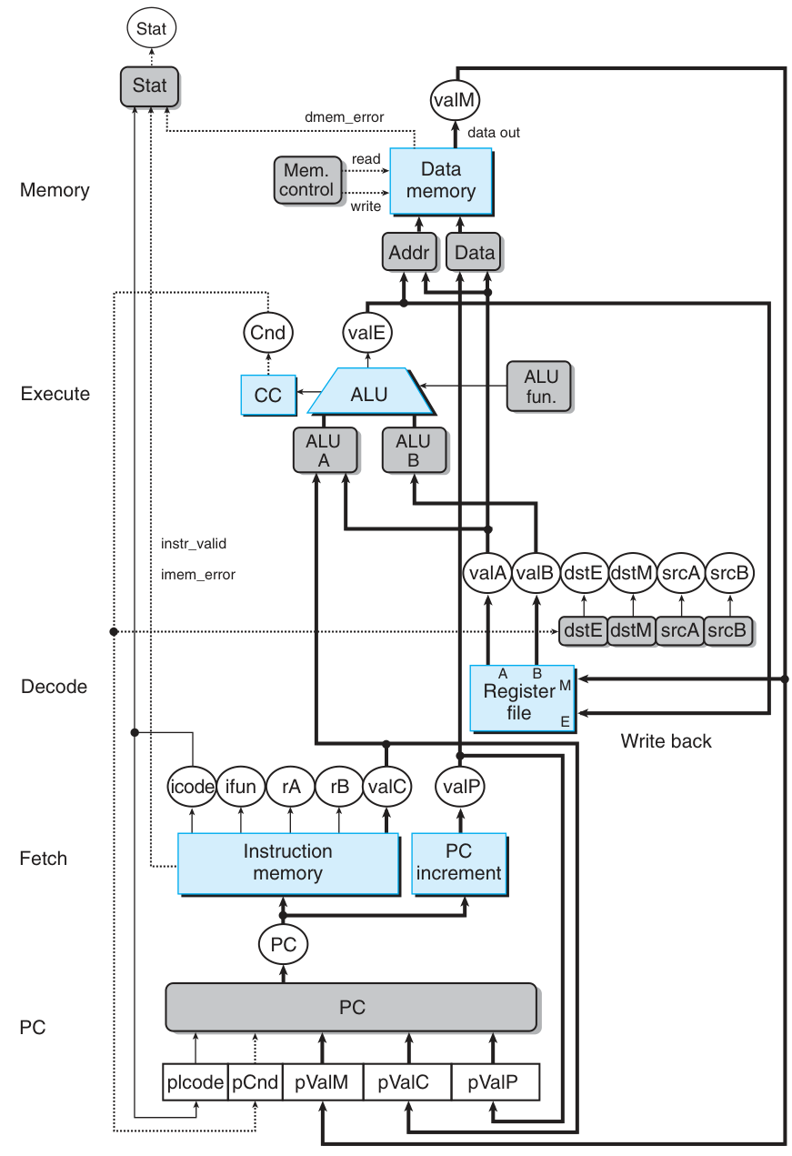
SEQ->SEQ+

Slide 61
SEQ->SEQ+
Circuit retiming
PC update stage
No hardware PC registers

Slide 62
SEQ+->PIPE-

Slide 63
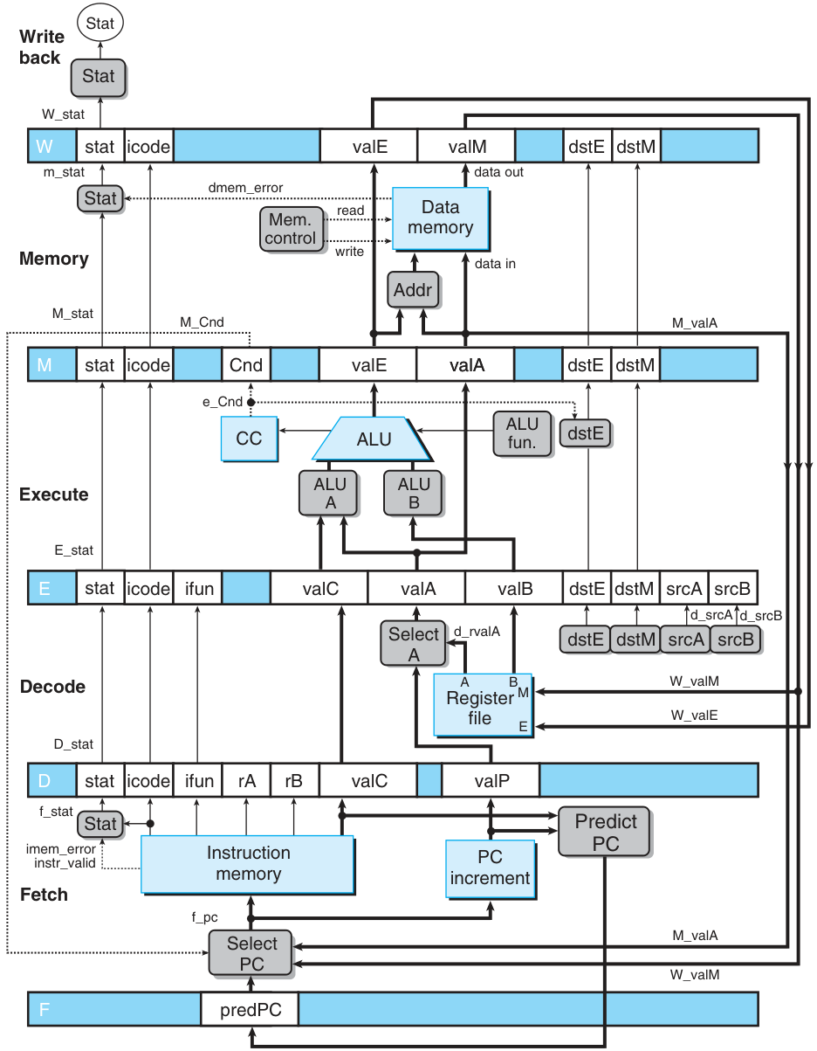
SEQ+->PIPE-
Adding pipeline registers
Select PC
Select A: Since valP is only used in the Memory period of call and in the Execute period of jXX and both of them do not need valA, Select A module is used to reduce the number of registers.

Slide 64
Problems: Data/Control Dependency
Data hazard
Control hazard

Slide 65
A Simple Solution: Bubbles and Stalls
Handling
data
hazard
Handling
control
hazard

Slide 66
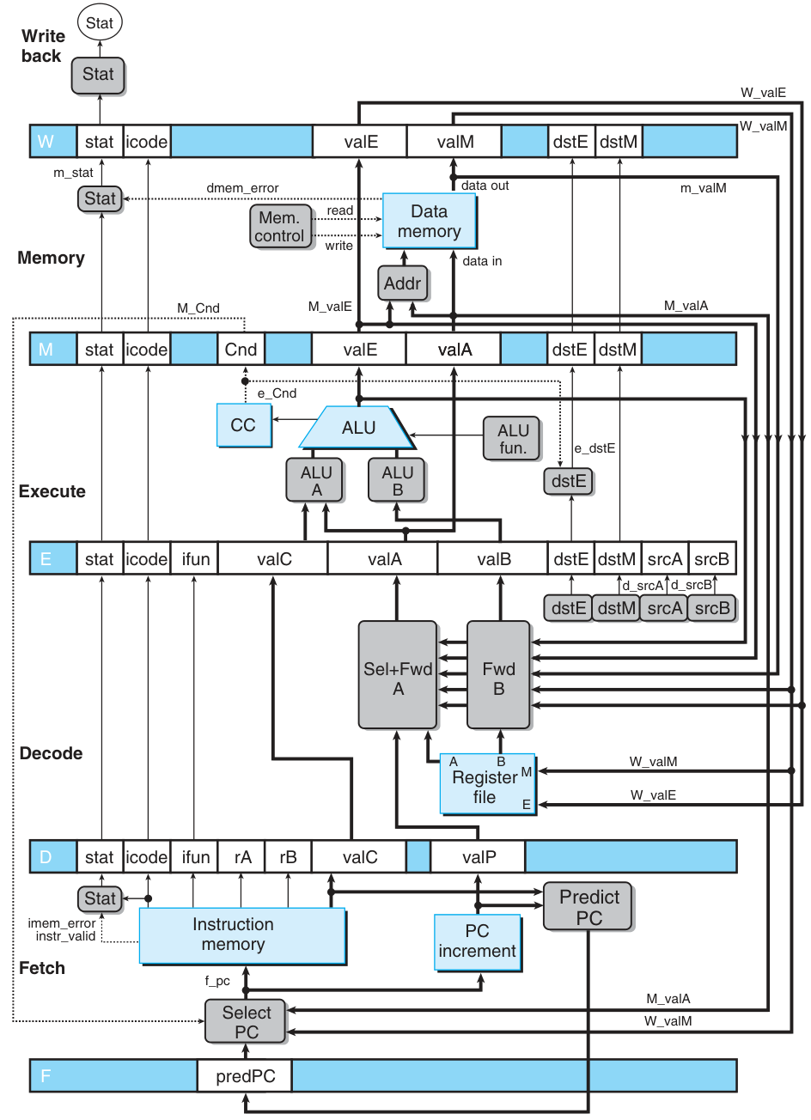
Another Solution: Forward
Need the data that has not written back to the registers when decoding.
Principle: Try to use forward. If failed, use stall.
Sel+Fwd A
Fwd B

Slide 67
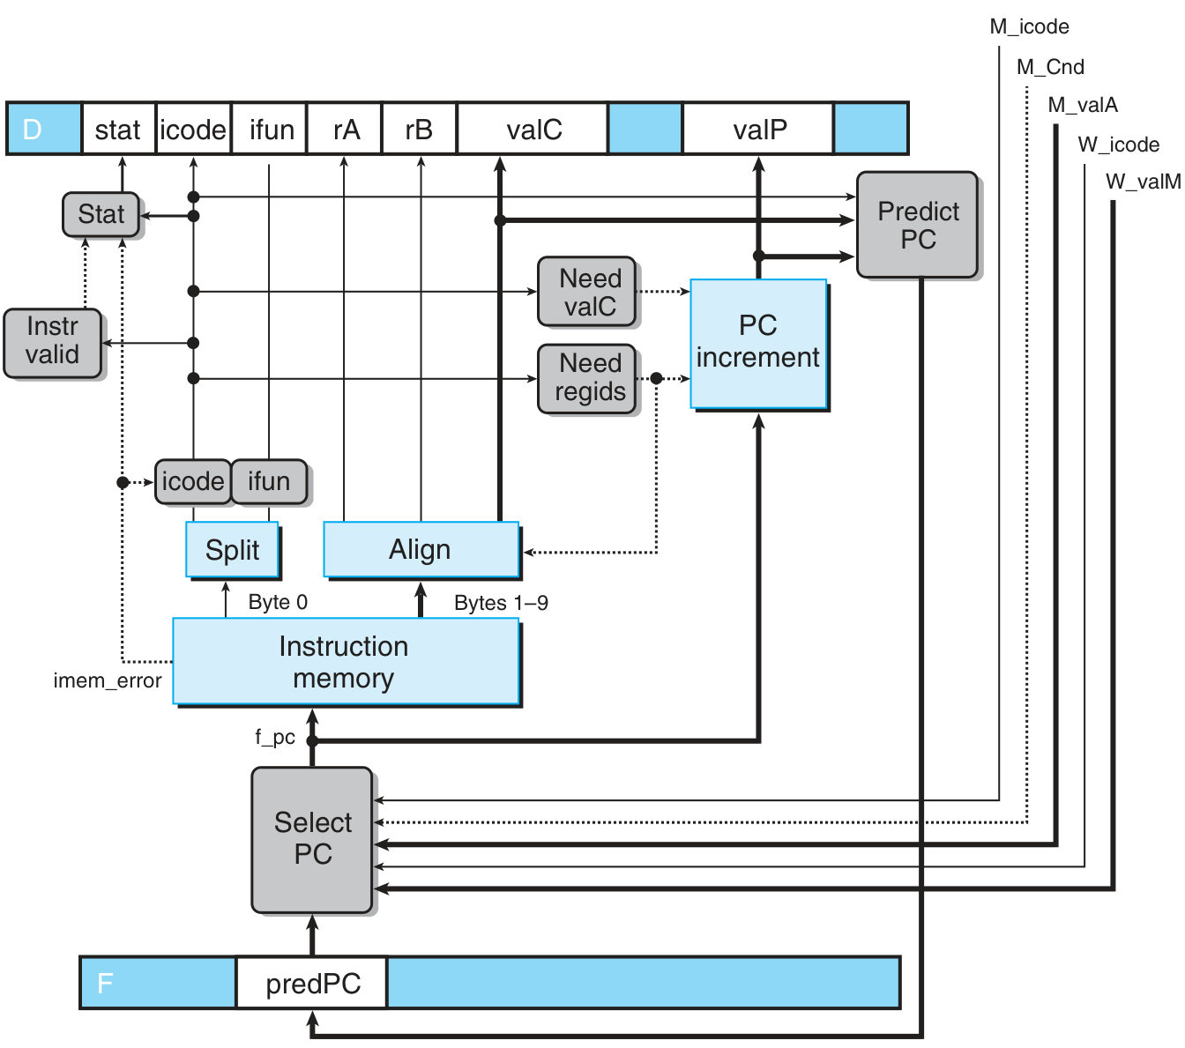
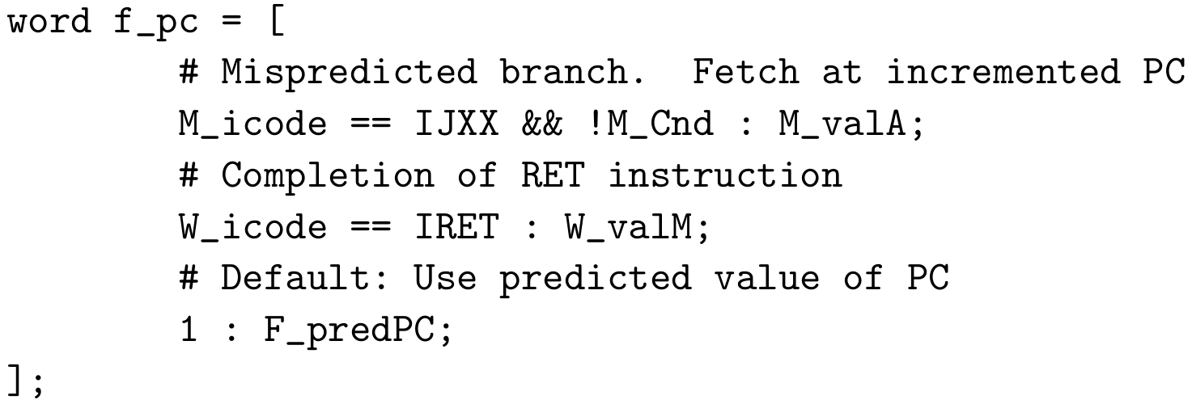
Modified HCL: Select PC & Fetch
HCL:

Slide 68
Modified HCL: Decode & Write back
Pay attention to the order!
HCL:

Slide 69
Modified HCL: Execute
HCL: left out

Slide 70
Modified HCL: Memory
HCL: left out

Slide 71
Hazard: Load/Use
You cannot just use forwarding to solve all the problems…
Last instruction reads data from memory to a register, and present instruction needs the data in this register.
Must stall and insert a bubble, then forward from memory stage.

Slide 72
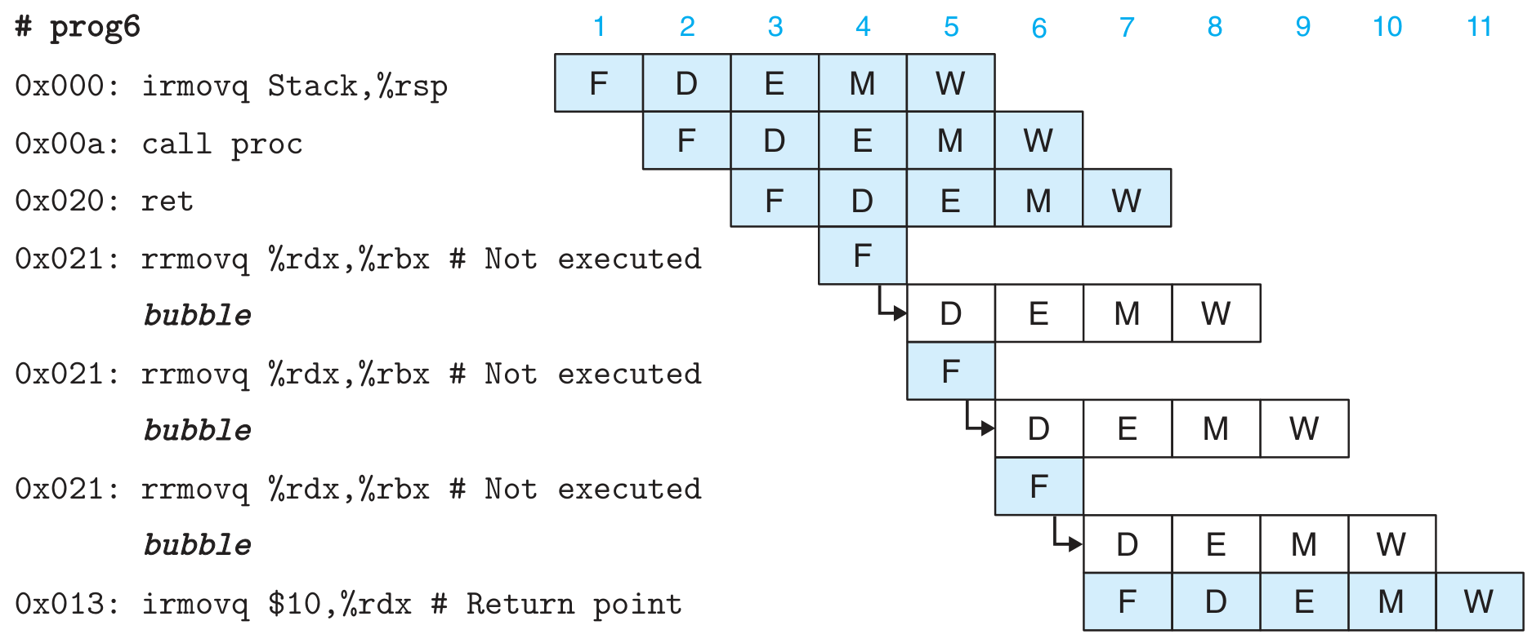
Hazard: ret
The PC of the next instruction of ret will be known until memory stage.
Insert three bubbles.

Slide 73
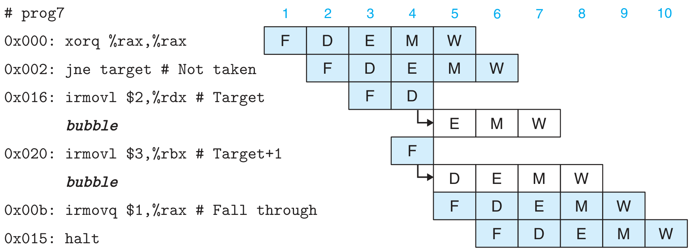
Hazard: Branch Misprediction
After Execute stage, the right branch will be known.
Insert two bubbles.

Slide 74
Hazard Combination

Slide 75
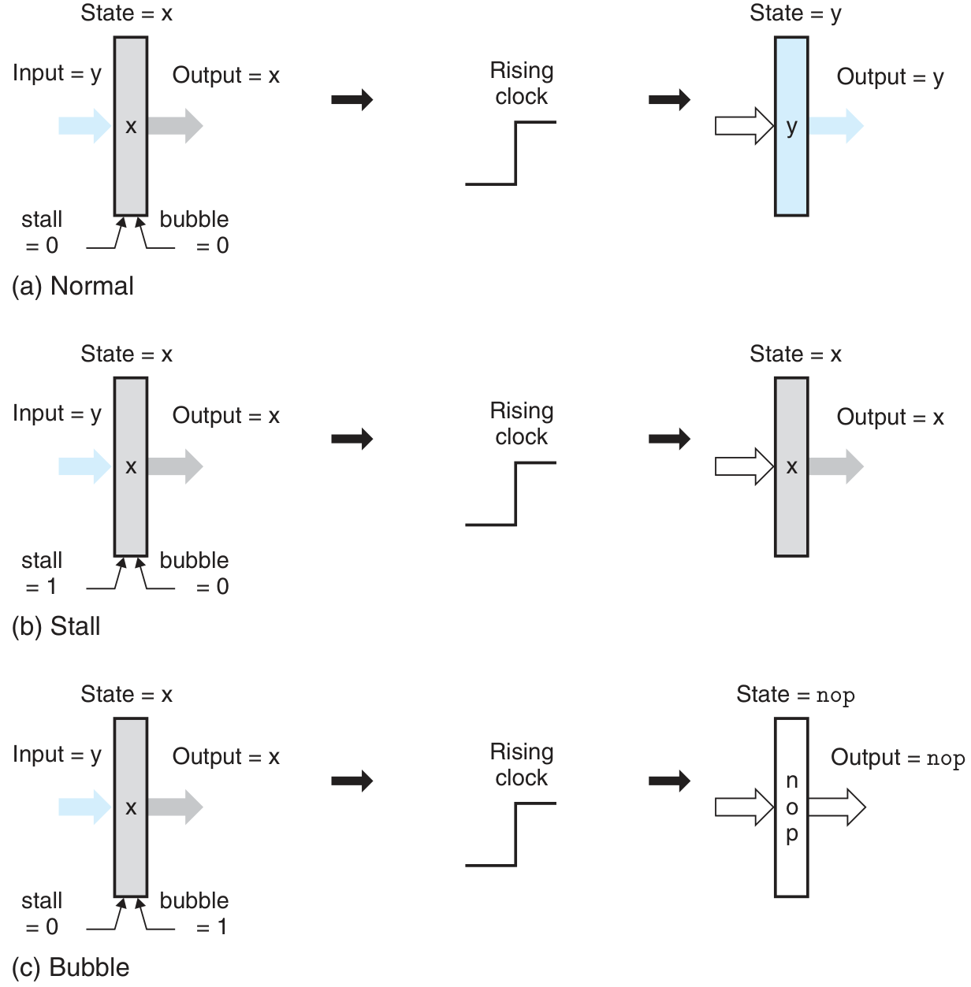
Hazard Detection & Control

Slide 76
Implementing Pipeline Control

